Slide 1
Cluster Analysis
A Linear-Algebra Approach to Unsupervised Learning
2
BDATA 412: Advanced Data Visualization
University of Washington

Slide 2



Course Roadmap
1
2
K-Means
Centroids, WCSS, Lloyd's algorithm
Foundations
Clusters, distance, norms, the data matrix $X$
3
Hierarchical
Dendrograms, linkage, Lance-Williams
4
DBSCAN
Density, neighborhoods, reachability
5
t-SNE
Affinities $P$, $Q$, KL divergence
6
UMAP
Fuzzy simplicial sets, graph $A$
7
Profiling
Cluster means, silhouette, validation

Slide 3
01
Foundations
Clusters, distance metrics, norms, and the data matrix $X$

Slide 4
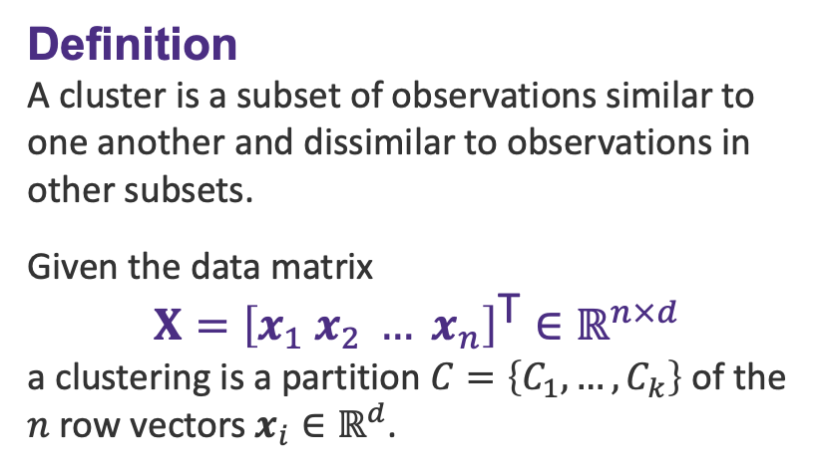
What Is a Cluster?
Definition
A cluster is a subset of observations similar to one another and dissimilar to observations in other subsets.
Given the data matrix
$$X={\left[x_{1} x_{2} … x_{n}\right]}^{\text{T}}∈ℝ^{n×d}$$
a clustering is a partition $C=\left\{C_{1},…,C_{k}\right\}$ of the $n$ row vectors $x_{i}∈ℝ^{d}$.
Three clusters in feature space: points within a group are close; groups are far apart.

Slide 5
Example: People, Features & Clusters
Person | Age | Income (k€) | Spend Score | Cluster
Ana | 23 | 28 | 82 | C₁
Ben | 21 | 24 | 88 | C₁
Cara | 45 | 76 | 33 | C₂
Dan | 48 | 82 | 29 | C₂
Eli | 36 | 55 | 58 | C₃
Fay | 39 | 58 | 54 | C₃
Each row is a person (observation); the feature columns form the data matrix X. People sharing a cluster have similar feature values — and differ from people in other clusters.

Slide 6
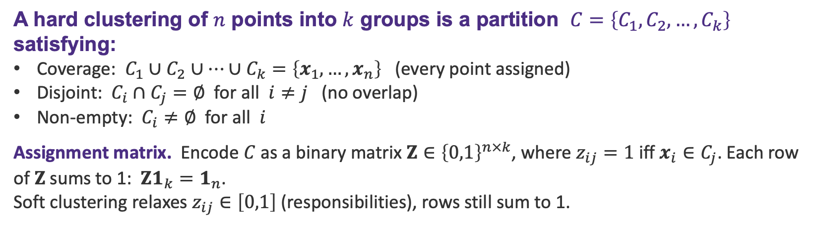
Clustering as a Partition
A hard clustering of $n$ points into $k$ groups is a partition $C=\left\{C_{1},C_{2},…,C_{k}\right\}$ satisfying:
Coverage: $C_{1}∪C_{2}∪…∪C_{k}=\left\{x_{1},…,x_{n}\right\}$ (every point assigned)
Disjoint: $C_{i}∩C_{j}=∅$ for all $i≠j$ (no overlap)
Non-empty: $C_{i}≠∅$ for all $i$
Assignment matrix. Encode $C$ as a binary matrix $Z∈{\left\{0,1\right\}}^{n×k}$, where $z_{ij}=1$ iff $x_{i}∈C_{j}$. Each row of $Z$ sums to 1: $Z1_{k}=1_{n}$.
Soft clustering relaxes $z_{ij}∈\left[0,1\right]$ (responsibilities), rows still sum to 1.

Slide 7
Exercise: Is It a Valid Clustering?
For each candidate C, decide whether it is a valid hard clustering of {x₁,…,x₆}. (Click to reveal each solution.)
(a) C₁={x₁,x₂}, C₂={x₃,x₄}, C₃={x₅,x₆}
✓ Valid — covers all 6 · disjoint · none empty
(b) C₁={x₁,x₂,x₃}, C₂={x₃,x₄,x₅,x₆}
✗ Invalid — Disjoint fails: x₃ ∈ C₁ ∩ C₂
(c) C₁={x₁,x₂}, C₂={x₄,x₅,x₆}
✗ Invalid — Coverage fails: x₃ unassigned
(d) C₁={x₁,…,x₆}, C₂=∅
✗ Invalid — Non-empty fails: C₂ = ∅

Slide 8
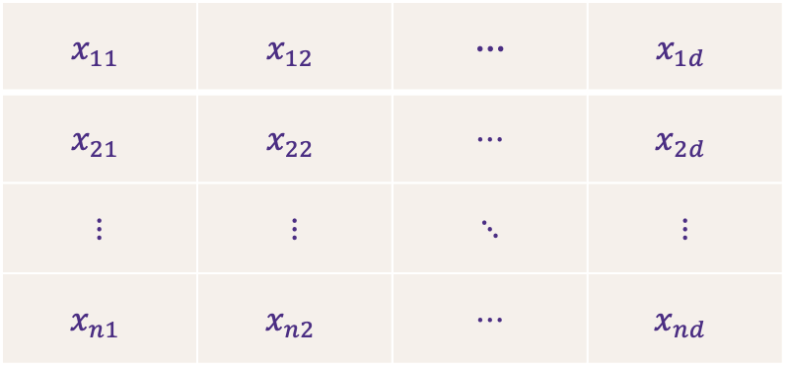
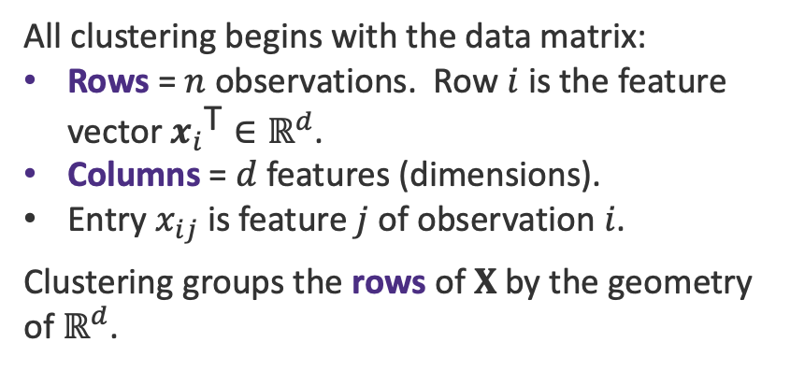
The Data Matrix X
All clustering begins with the data matrix:
Rows = $n$ observations. Row $i$ is the feature vector ${x_{i}}^{\text{T}}∈ℝ^{d}$.
Columns = $d$ features (dimensions).
Entry $x_{ij}$ is feature $j$ of observation $i$.
Clustering groups the rows of $X$ by the geometry of $ℝ^{d}$.
$$x_{11}$$ | $$x_{12}$$ | ⋯ | $$x_{1d}$$
$$x_{21}$$ | $$x_{22}$$ | ⋯ | $$x_{2d}$$
⋮ | ⋮ | ⋱ | ⋮
$$x_{n1}$$ | $$x_{n2}$$ | ⋯ | $$x_{nd}$$
$X∈ℝ^{n×d}$ (n rows = observations, d cols = features)

Slide 9
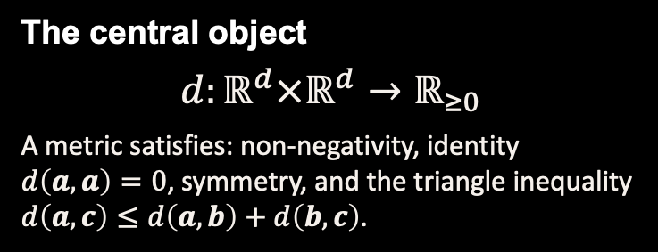
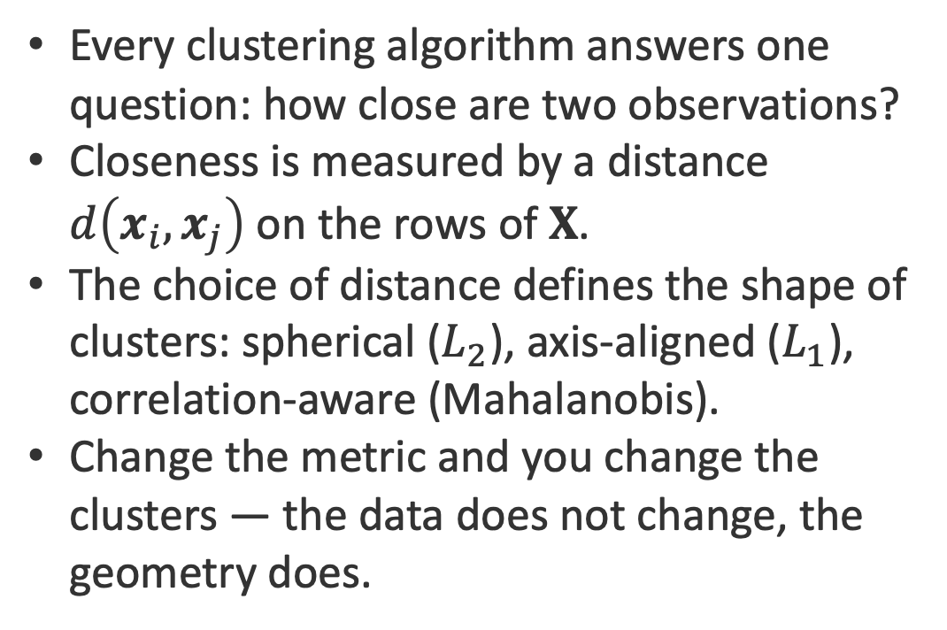
Why Distance Matters
Every clustering algorithm answers one question: how close are two observations?
Closeness is measured by a distance $d\left(x_{i},x_{j}\right)$ on the rows of $X$.
The choice of distance defines the shape of clusters: spherical ($L_{2}$), axis-aligned ($L_{1}$), correlation-aware (Mahalanobis).
Change the metric and you change the clusters — the data does not change, the geometry does.
The central object
$$d:ℝ^{d}×ℝ^{d}→ℝ_{≥0}$$
A metric satisfies: non-negativity, identity $d\left(a,a\right)=0$, symmetry, and the triangle inequality $d\left(a,c\right)≤d\left(a,b\right)+d\left(b,c\right)$.

Slide 10
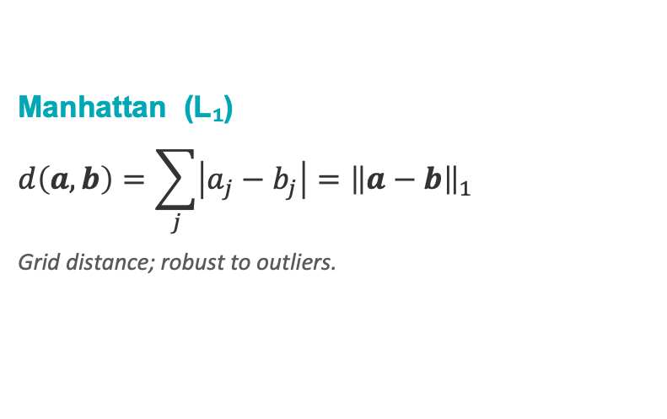
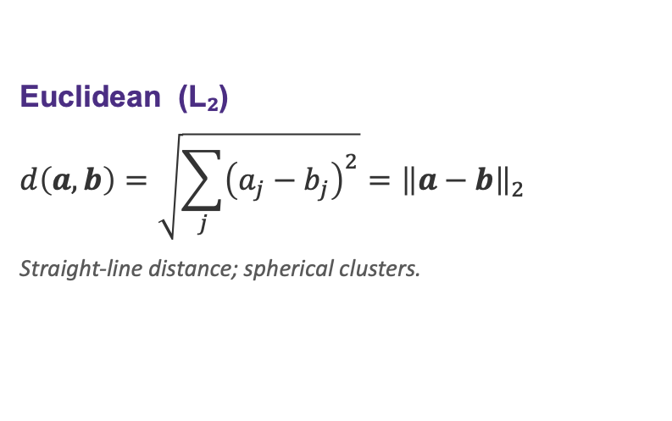
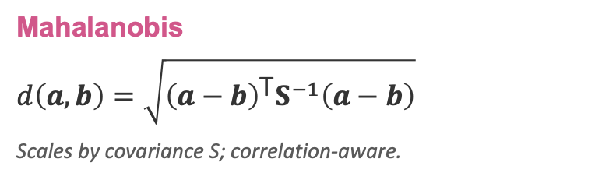
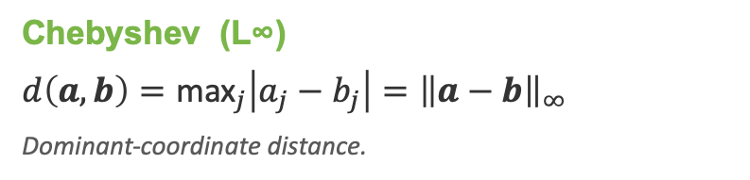
Distance Metrics & Norms
Euclidean (L₂)
$$d\left(a,b\right)=\sqrt{\sum_{j}{{\left(a_{j}−b_{j}\right)}^{2}}}={\left\|a−b\right\|}_{2}$$
Straight-line distance; spherical clusters.
Manhattan (L₁)
$$d\left(a,b\right)=\sum_{j}{\left|a_{j}−b_{j}\right|}={\left\|a−b\right\|}_{1}$$
Grid distance; robust to outliers.
Chebyshev (L∞)
$$d\left(a,b\right)={\text{max}}_{j}\left|a_{j}−b_{j}\right|={\left\|a−b\right\|}_{∞}$$
Dominant-coordinate distance.
Mahalanobis
$$d\left(a,b\right)=\sqrt{{\left(a−b\right)}^{\text{T}}S^{−1}\left(a−b\right)}$$
Scales by covariance S; correlation-aware.

Slide 11
Distances in 2D — Visual Intuition
Euclidean (L₂)
Manhattan (L₁)
b
Straight line between the points: √(Δx²+Δy²) = √(80²+58²) ≈ 99.
b
Move only along the axes, like city blocks: |Δx| + |Δy| = 80 + 58 = 138.
a
a
Chebyshev (L∞)
Mahalanobis
b
Only the largest coordinate gap counts: max(80, 58) = 80 — a king's move on a chessboard.
b
Equal-distance contours are ellipses set by the covariance; the same gap counts for less along the direction of spread.
a
a

Slide 12
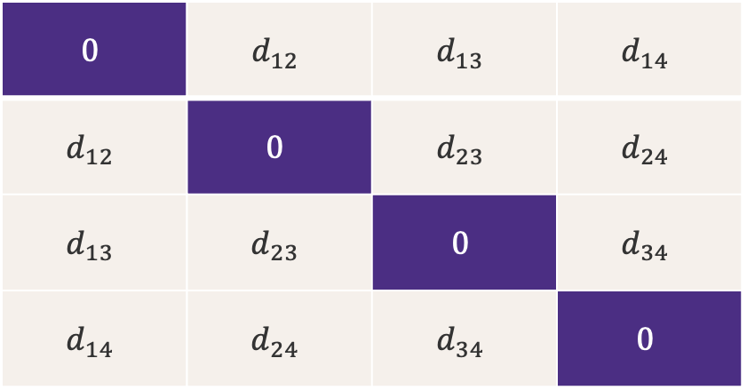
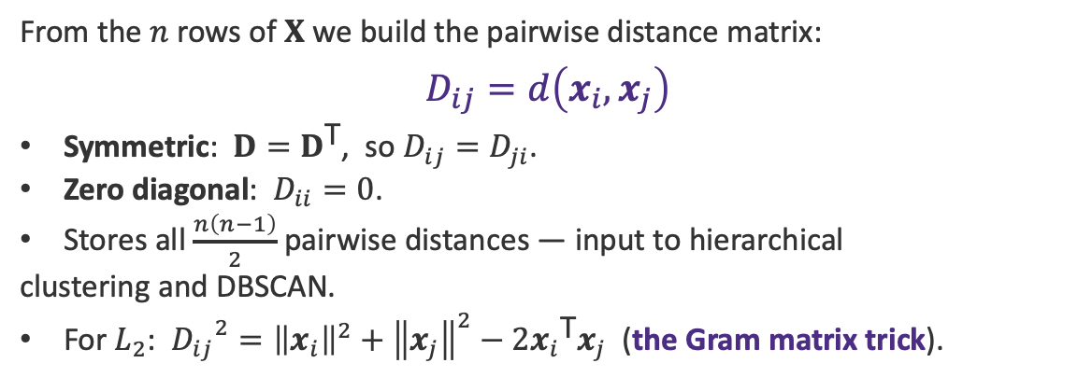
The Distance Matrix D
From the $n$ rows of $X$ we build the pairwise distance matrix:
$$D_{ij}=d\left(x_{i},x_{j}\right)$$
Symmetric: $D=D^{\text{T}}$, so $D_{ij}=D_{ji}$.
Zero diagonal: $D_{ii}=0$.
Stores all $\frac{n\left(n−1\right)}{2}$ pairwise distances — input to hierarchical
clustering and DBSCAN.
For $L_{2}$: ${D_{ij}}^{2}={\left\|x_{i}\right\|}^{2}+{\left\|x_{j}\right\|}^{2}−2{x_{i}}^{\text{T}}x_{j}$ (the Gram matrix trick).
$$0$$ | $$d_{12}$$ | $$d_{13}$$ | $$d_{14}$$
$$d_{12}$$ | $$0$$ | $$d_{23}$$ | $$d_{24}$$
$$d_{13}$$ | $$d_{23}$$ | $$0$$ | $$d_{34}$$
$$d_{14}$$ | $$d_{24}$$ | $$d_{34}$$ | $$0$$
$D∈ℝ^{n×n}$ is symmetric ($D=D^{\text{T}}$) with zero diagonal.

Slide 13
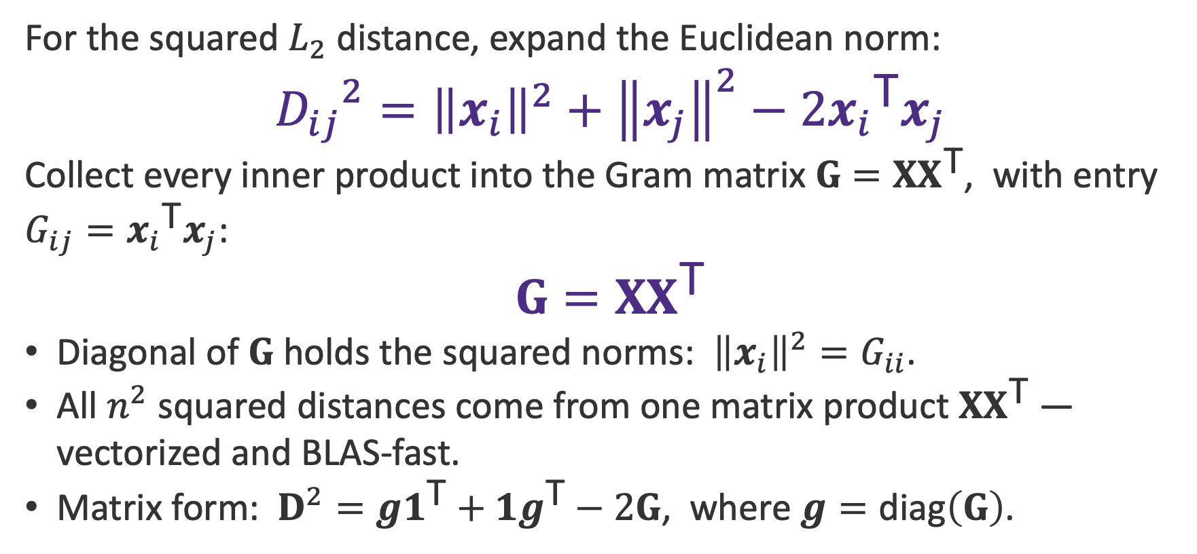
Squared Distances: The Gram Matrix Trick
For the squared $L_{2}$ distance, expand the Euclidean norm:
$${D_{ij}}^{2}={\left\|x_{i}\right\|}^{2}+{\left\|x_{j}\right\|}^{2}−2{x_{i}}^{\text{T}}x_{j}$$
Collect every inner product into the Gram matrix $G=XX^{\text{T}}$, with entry $G_{ij}={x_{i}}^{\text{T}}x_{j}$:
$$G=XX^{\text{T}}$$
Diagonal of $G$ holds the squared norms: ${\left\|x_{i}\right\|}^{2}=G_{ii}$.
All $n^{2}$ squared distances come from one matrix product $XX^{\text{T}}$ — vectorized and BLAS-fast.
Matrix form: $D^{2}=g1^{\text{T}}+1g^{\text{T}}−2G$, where $g=\text{diag}\left(G\right)$.

Slide 14
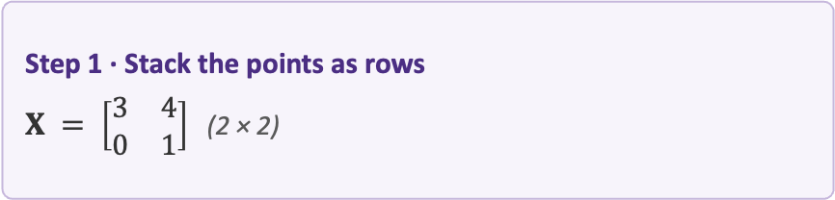


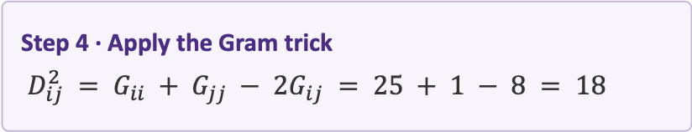
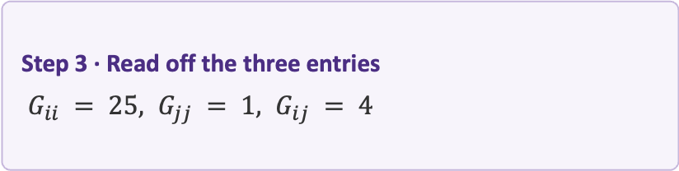
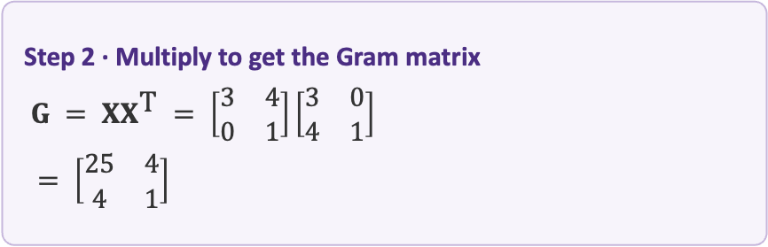
Example: A Distance via the Gram Trick
Problem. Given $x_{i} = (3, 4)$ and $x_{j} = (0, 1)$ in $ℝ^{2},$ compute $D_{ij}^{2}$ with the Gram trick.
Click to reveal each step.
Step 1 · Stack the points as rows
$X = \left[\begin{matrix}3 & 4 \\ 0 & 1\end{matrix}\right]$ (2 × 2)
Step 3 · Read off the three entries
$G_{ii} = 25, G_{jj} = 1, G_{ij} = 4$
Step 2 · Multiply to get the Gram matrix
$G = XX^{\text{T}} = \left[\begin{matrix}3 & 4 \\ 0 & 1\end{matrix}\right]\left[\begin{matrix}3 & 0 \\ 4 & 1\end{matrix}\right]$
$= \left[\begin{matrix}25 & 4 \\ 4 & 1\end{matrix}\right]$
Step 4 · Apply the Gram trick
$D_{ij}^{2} = G_{ii} + G_{jj} − 2G_{ij} = 25 + 1 − 8 = 18$
Result: $D_{ij} = \sqrt{18} = 3\sqrt{2} ≈ 4.24$

Slide 15

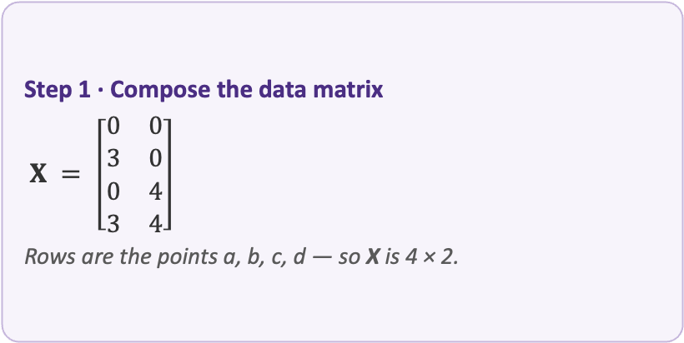
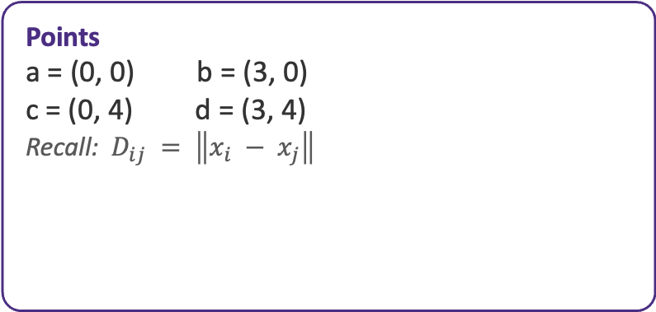
Exercise: Build the Distance Matrix
Problem. For the four points below in $ℝ^{2},$ build the $4×4$ Euclidean distance matrix D.
Click to reveal each step.
Points
a = (0, 0) b = (3, 0)
c = (0, 4) d = (3, 4)
Recall: $D_{ij} = \left\|x_{i} − x_{j}\right\|$
Step 1 · Compose the data matrix
$X = \left[\begin{matrix}0 & 0 \\ 3 & 0 \\ 0 & 4 \\ 3 & 4\end{matrix}\right]$
Rows are the points a, b, c, d — so X is 4 × 2.

Slide 16

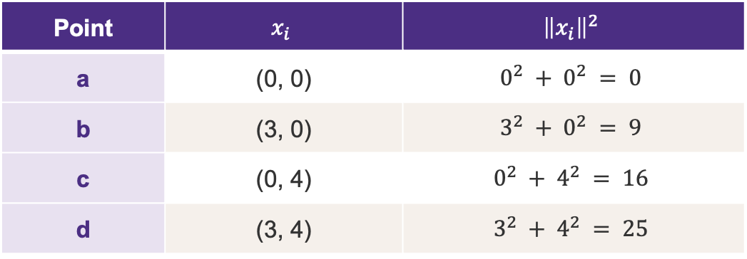
Solution — Step 2: Multiply — the Diagonal of $XX^{T}$
For $L_{2}$ (Gram trick): $D_{ij}^{2} = {\left\|x_{i}\right\|}^{2} + {\left\|x_{j}\right\|}^{2} − 2 x_{i}^{T} x_{j}$
Point | $$x_{i}$$ | $${\left\|x_{i}\right\|}^{2}$$
a | (0, 0) | $$0^{2} + 0^{2} = 0$$
b | (3, 0) | $$3^{2} + 0^{2} = 9$$
c | (0, 4) | $$0^{2} + 4^{2} = 16$$
d | (3, 4) | $$3^{2} + 4^{2} = 25$$
These four values become the diagonal of the Gram matrix G.

Slide 17

Solution — Step 3: Gram Matrix $G = XX^{T}$
For $L_{2}$ (Gram trick): $D_{ij}^{2} = {\left\|x_{i}\right\|}^{2} + {\left\|x_{j}\right\|}^{2} − 2 x_{i}^{T} x_{j}$
G | a | b | c | d
a | 0 | 0 | 0 | 0
b | 0 | 9 | 0 | 9
c | 0 | 0 | 16 | 16
d | 0 | 9 | 16 | 25
$G_{ij} = x_{i}^{T} x_{j}$ — its diagonal equals the squared norms ${\left\|x_{i}\right\|}^{2}$ from Step 2.

Slide 18

Solution — Step 4: Gram Trick → $D_{ij}^{2}$
For $L_{2}$ (Gram trick): $D_{ij}^{2} = {\left\|x_{i}\right\|}^{2} + {\left\|x_{j}\right\|}^{2} − 2 x_{i}^{T} x_{j}$
D² | a | b | c | d
a | 0 | 9 | 16 | 25
b | 9 | 0 | 25 | 16
c | 16 | 25 | 0 | 9
d | 25 | 16 | 9 | 0
$D_{ij}^{2} = {\left\|x_{i}\right\|}^{2} + {\left\|x_{j}\right\|}^{2} − 2G_{ij}.$ e.g. $D^{2}(b,d) = 9 + 25 −$ 2(9) = 16.

Slide 19
Solution — Step 5: Distance Matrix D
Take entrywise square roots: $D_{ij} = \sqrt{D_{ij}^{2}}$
D | a | b | c | d
a | 0 | 3 | 4 | 5
b | 3 | 0 | 5 | 4
c | 4 | 5 | 0 | 3
d | 5 | 4 | 3 | 0
Symmetric with zero diagonal — the 3-4-5 rectangle. This matches the exercise answer.

Slide 20
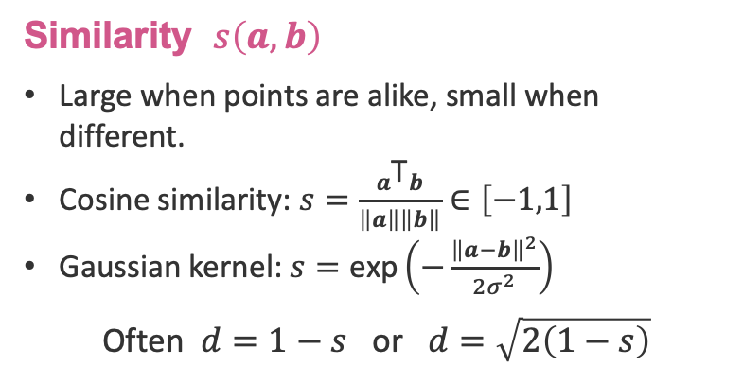
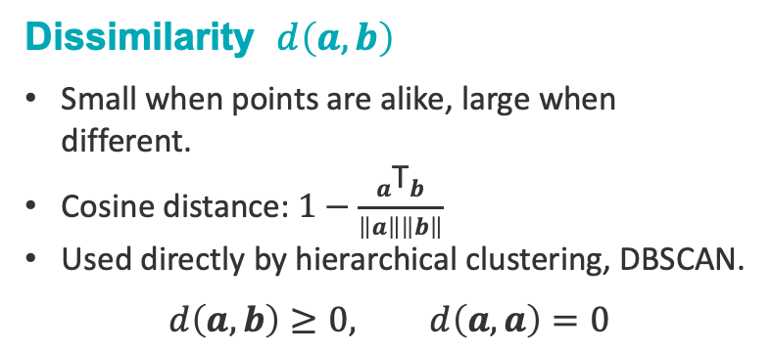
Similarity vs. Dissimilarity
Dissimilarity $d\left(a,b\right)$
Small when points are alike, large when different.
Cosine distance: $1−\frac{a^{\text{T}}b}{\left\|a\right\|\left\|b\right\|}$
Used directly by hierarchical clustering, DBSCAN.
$$d\left(a,b\right)≥0, d\left(a,a\right)=0$$
Similarity $s\left(a,b\right)$
Large when points are alike, small when different.
Cosine similarity: $s=\frac{a^{\text{T}}b}{\left\|a\right\|\left\|b\right\|}∈\left[−1,1\right]$
Gaussian kernel: $s=\text{exp}\left(−\frac{{\left\|a−b\right\|}^{2}}{2σ^{2}}\right)$
Often $d=1−s$ or $d=\sqrt{2\left(1−s\right)}$

Slide 21

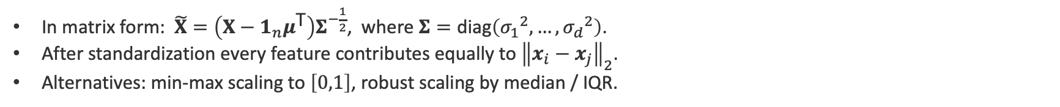
Standardization
Euclidean distance is dominated by large-scale features. A variable in dollars (${10}^{5}$) swamps one in years (${10}^{1}$). We rescale each column $j$ of $X$ to zero mean and unit variance:
${\tilde{x}}_{ij}=\frac{\left(x_{ij}−μ_{j}\right)}{σ_{j}}$ $μ_{j}=\frac{1}{n}\sum_{i}{x_{ij}}$
In matrix form: $\tilde{X}=\left(X−1_{n}μ^{\text{T}}\right)Σ^{−\frac{1}{2}}$, where $Σ=\text{diag}\left({σ_{1}}^{2},…,{σ_{d}}^{2}\right)$.
After standardization every feature contributes equally to ${\left\|x_{i}−x_{j}\right\|}_{2}$.
Alternatives: min-max scaling to $\left[0,1\right]$, robust scaling by median / IQR.

Slide 22
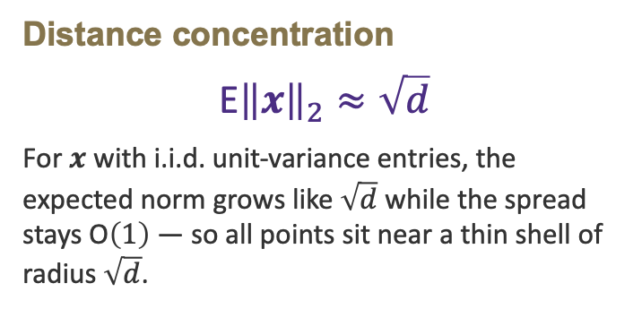
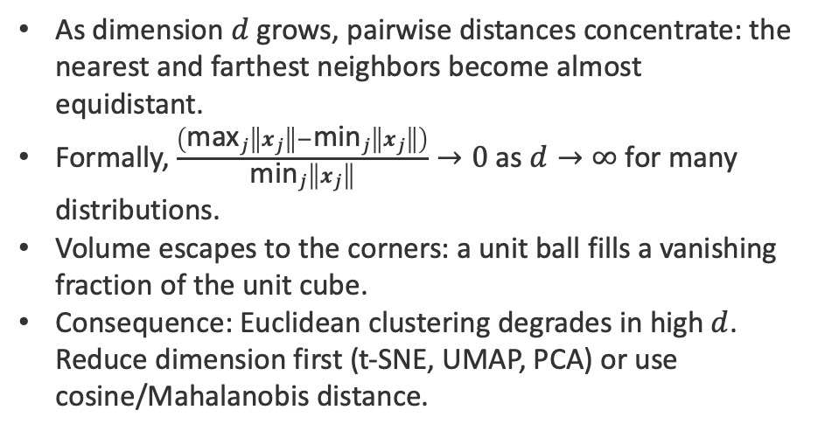
The Curse of Dimensionality
As dimension $d$ grows, pairwise distances concentrate: the nearest and farthest neighbors become almost equidistant.
Formally, $\frac{\left({\text{max}}_{j}\left\|x_{j}\right\|−{\text{min}}_{j}\left\|x_{j}\right\|\right)}{{\text{min}}_{j}\left\|x_{j}\right\|}→0$ as $d→∞$ for many distributions.
Volume escapes to the corners: a unit ball fills a vanishing fraction of the unit cube.
Consequence: Euclidean clustering degrades in high $d$. Reduce dimension first (t-SNE, UMAP, PCA) or use cosine/Mahalanobis distance.
Distance concentration
$$\text{E}{\left\|x\right\|}_{2}≈\sqrt{d}$$
For $x$ with i.i.d. unit-variance entries, the expected norm grows like $\sqrt{d}$ while the spread stays $\text{O}\left(1\right)$ — so all points sit near a thin shell of radius $\sqrt{d}$.

Slide 23
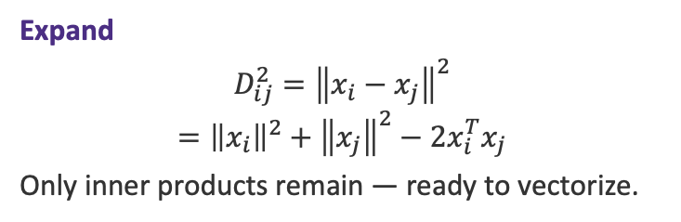
Step 1 — Expand the Squared Distance
STEP 1 OF 4
Idea
A Euclidean distance can’t be vectorized directly — the square root blocks it.
Square the distance and expand the norm. Every term becomes an inner product, and inner products are exactly what one matrix multiply delivers.
Goal: rewrite each distance using only dot products of the data points.
Expand
$$D_{ij}^{2}={\left\|x_{i}−x_{j}\right\|}^{2}$$
$$={\left\|x_{i}\right\|}^{2}+{\left\|x_{j}\right\|}^{2}−2x_{i}^{T}x_{j}$$
Only inner products remain — ready to vectorize.

Slide 24
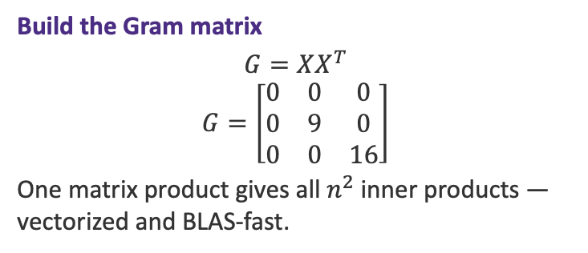
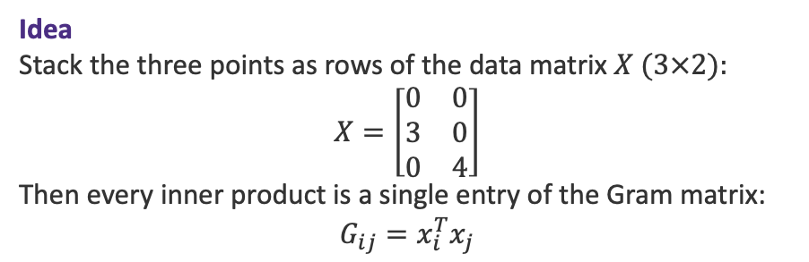
Step 2 — Collect Into the Gram Matrix
STEP 2 OF 4
Idea
Stack the three points as rows of the data matrix $X (3×2):$
$$X=\left[\begin{matrix}0 & 0 \\ 3 & 0 \\ 0 & 4\end{matrix}\right]$$
Then every inner product is a single entry of the Gram matrix:
$$G_{ij}=x_{i}^{T}x_{j}$$
Build the Gram matrix
$$G=XX^{T}$$
$$G=\left[\begin{matrix}0 & 0 & 0 \\ 0 & 9 & 0 \\ 0 & 0 & 16\end{matrix}\right]$$
One matrix product gives all $n^{2}$ inner products — vectorized and BLAS-fast.

Slide 25
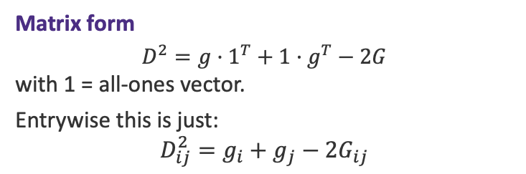
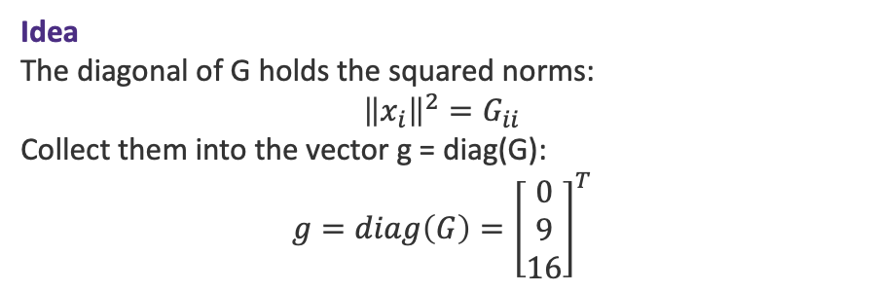
Step 3 — Diagonal & Matrix Form
STEP 3 OF 4
Idea
The diagonal of G holds the squared norms:
$${\left\|x_{i}\right\|}^{2}=G_{ii}$$
Collect them into the vector g = diag(G):
$$g=diag\left(G\right)={\left[\begin{matrix}0 \\ 9 \\ 16\end{matrix}\right]}^{T}$$
Matrix form
$$D^{2}=g·1^{T}+1·g^{T}−2G$$
with 1 = all-ones vector.
Entrywise this is just:
$$D_{ij}^{2}=g_{i}+g_{j}−2G_{ij}$$

Slide 26
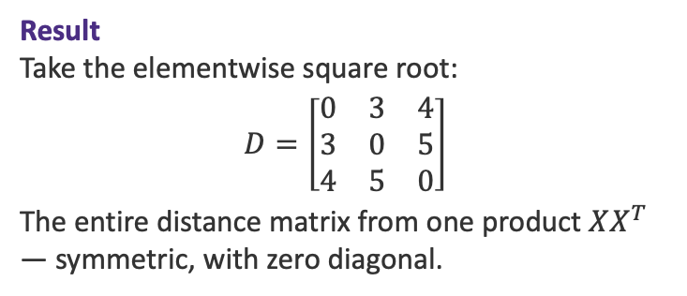
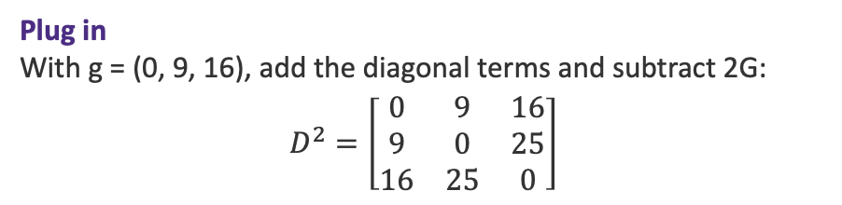
Step 4 — Plug In and Recover D
STEP 4 OF 4
Plug in
With g = (0, 9, 16), add the diagonal terms and subtract 2G:
$$D^{2}=\left[\begin{matrix}0 & 9 & 16 \\ 9 & 0 & 25 \\ 16 & 25 & 0\end{matrix}\right]$$
Result
Take the elementwise square root:
$$D=\left[\begin{matrix}0 & 3 & 4 \\ 3 & 0 & 5 \\ 4 & 5 & 0\end{matrix}\right]$$
The entire distance matrix from one product $XX^{T}$ — symmetric, with zero diagonal.

Slide 27
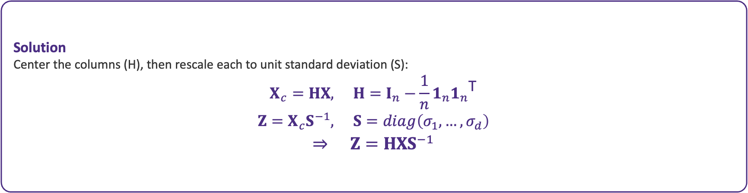
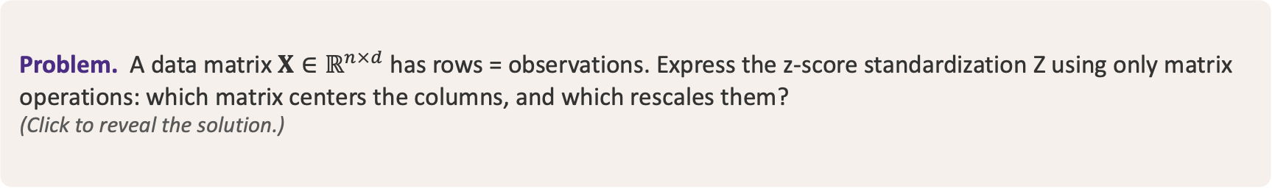
Exercise 1: Standardization in Matrix Form
Problem. A data matrix $X∈ℝ^{n×d}$ has rows = observations. Express the z-score standardization Z using only matrix operations: which matrix centers the columns, and which rescales them?
(Click to reveal the solution.)
Solution
Center the columns (H), then rescale each to unit standard deviation (S):
$$X_{c}=HX, H=I_{n}−\frac{1}{n}1_{n}{1_{n}}^{\text{T}}$$
$$Z=X_{c}S^{−1}, S=diag\left(σ_{1},…,σ_{d}\right)$$
$$⇒ Z=HXS^{−1}$$

Slide 28
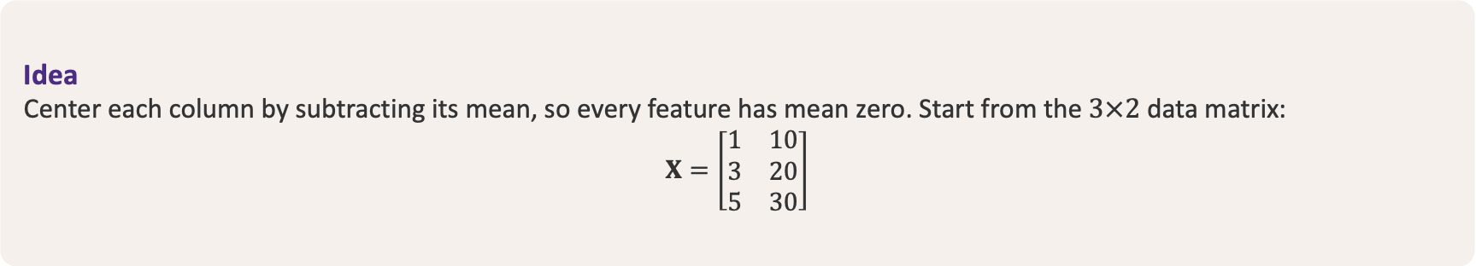
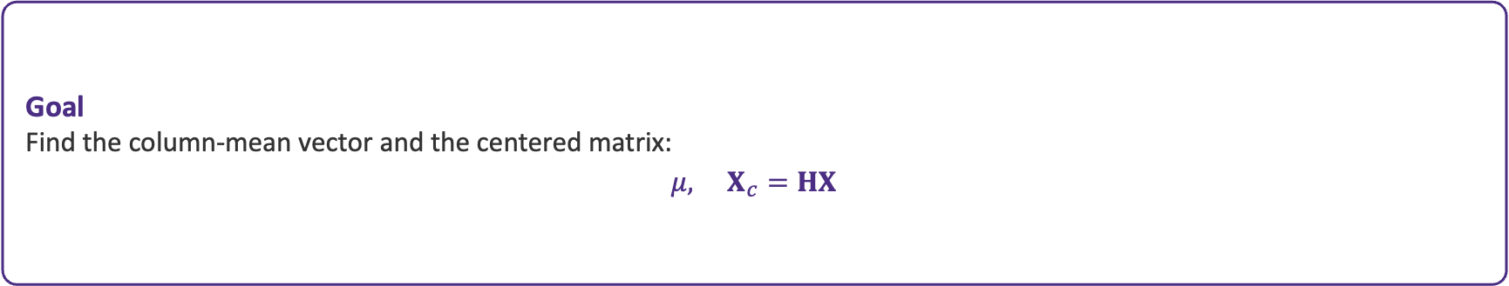
Exercise 2 — Step 1: Set Up the Centering
STEP 1 OF $4 ·$ Centering operator: $H=I_{n}−\frac{1}{n}11^{\text{T}}$
Idea
Center each column by subtracting its mean, so every feature has mean zero. Start from the $3×2$ data matrix:
$$X=\left[\begin{matrix}1 & 10 \\ 3 & 20 \\ 5 & 30\end{matrix}\right]$$
Goal
Find the column-mean vector and the centered matrix:
$$μ, X_{c}=HX$$

Slide 29

Exercise 2 — Step 2: Column Means
STEP 2 OF $4 ·$ Column means: $μ=\frac{1}{n}X^{\text{T}}1_{n}$
Idea
Average each column: sum the entries down each column, then divide by the number of rows n = 3.
Work
Sum each column, then divide by n = 3:
$$(1 + 3 + 5, 10 + 20 + 30) = (9, 60)$$
$$μ=\frac{1}{3}(9, 60) = (3, 20)$$

Slide 30
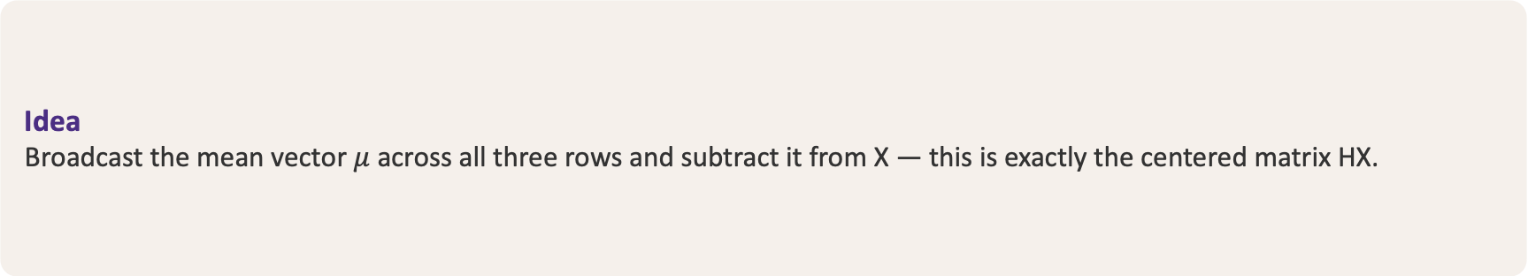

Exercise 2 — Step 3: Subtract the Means
STEP 3 OF $4 ·$ Centered matrix: $X_{c}=X−1_{n}μ^{\text{T}}=HX$
Idea
Broadcast the mean vector $μ$ across all three rows and subtract it from X — this is exactly the centered matrix HX.
Work
$$X_{c}=\left[\begin{matrix}1 & 10 \\ 3 & 20 \\ 5 & 30\end{matrix}\right]−\left[\begin{matrix}3 & 20 \\ 3 & 20 \\ 3 & 20\end{matrix}\right]=\left[\begin{matrix}−2 & −10 \\ 0 & 0 \\ 2 & 10\end{matrix}\right]$$

Slide 31

Exercise 2 — Step 4: Check & Standardize
STEP 4 OF $4 ·$ Each column of $X_{c}$ now has mean $0$
Why it matters
Every column of the centered matrix now sums to zero, so the data is mean-centered — exactly what covariance estimation and PCA require.
Standardize next
Divide each centered column by its standard deviation to put every feature on one scale:
$$Z=HXS^{−1}$$

Slide 32
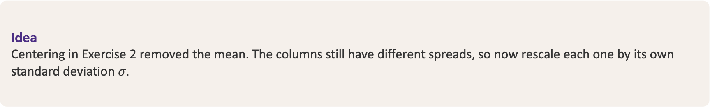
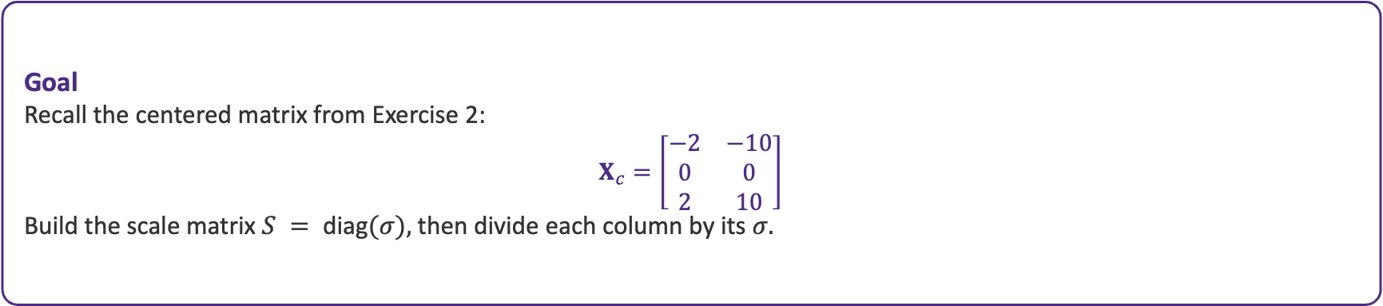
Exercise 3 — Step 1: Set Up the Scaling
STEP 1 OF $4 ·$ Standardize: $Z=X_{c}S^{−1}$ (S = diag of column std-devs)
Idea
Centering in Exercise 2 removed the mean. The columns still have different spreads, so now rescale each one by its own standard deviation $σ.$
Goal
Recall the centered matrix from Exercise 2:
$$X_{c}=\left[\begin{matrix}−2 & −10 \\ 0 & 0 \\ 2 & 10\end{matrix}\right]$$
Build the scale matrix $S = \text{diag}(σ),$ then divide each column by its $σ.$

Slide 33


Exercise 3 — Step 2: Column Standard Deviations
STEP 2 OF $4 ·$ Sample std-dev $σ_{j}=\sqrt{\frac{1}{n − 1}\sum_{i}{{x_{ij}}^{2}}}$
Idea
Each centered column already has mean 0, so its variance is the mean of its squares. Divide the sum of squares by n − 1 = 2, then take the square root.
Work
$$σ_{1}=\sqrt{\frac{(−2)² + 0² + 2²}{2}}=\sqrt{\frac{8}{2}}=2$$
$$σ_{2}=\sqrt{\frac{(−10)² + 0² + 10²}{2}}=\sqrt{\frac{200}{2}}=10$$
$$σ=(2, 10)$$

Slide 34

Exercise 3 — Step 3: Build the Scaling Matrix
STEP 3 OF $4 ·$ $S=diag(σ), S^{−1}=diag(\frac{1}{σ})$
Idea
Place the standard deviations on the diagonal of S. Its inverse simply reciprocates each diagonal entry — the off-diagonals stay zero.
Work
$$S=diag(2, 10)=\left[\begin{matrix}2 & 0 \\ 0 & 10\end{matrix}\right]$$
$$S^{−1}=diag(\frac{1}{2}, \frac{1}{10})=\left[\begin{matrix}\frac{1}{2} & 0 \\ 0 & \frac{1}{10}\end{matrix}\right]$$

Slide 35
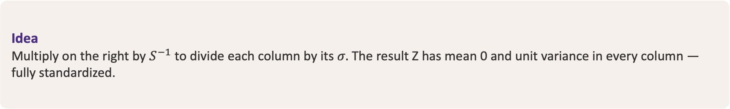

Exercise 3 — Step 4: Scale to Unit Variance
STEP 4 OF $4 ·$ $Z=X_{c}S^{−1}$ $→$ every column: mean 0, variance 1
Idea
Multiply on the right by $S^{−1}$ to divide each column by its $σ.$ The result Z has mean 0 and unit variance in every column — fully standardized.
Work
$$Z=\left[\begin{matrix}−2 & −10 \\ 0 & 0 \\ 2 & 10\end{matrix}\right]·\left[\begin{matrix}\frac{1}{2} & 0 \\ 0 & \frac{1}{10}\end{matrix}\right]$$
$$=\left[\begin{matrix}−1 & −1 \\ 0 & 0 \\ 1 & 1\end{matrix}\right]$$

Slide 36
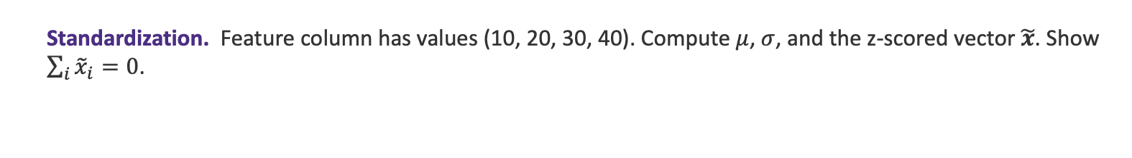
Foundations — Exercises
E1
Distance matrix. Given $a=\left(1,2\right)$, $b=\left(4,6\right)$, $c=\left(1,6\right)$ in $ℝ^{2}$, compute the $3×3$ Euclidean matrix $D$. Verify $D=D^{\text{T}}$ and zero diagonal.
E2
Metric comparison. For $a=\left(2,0,1\right)$, $b=\left(0,3,1\right)$, compute ${\left\|a−b\right\|}_{1}$, ${\left\|a−b\right\|}_{2}$, and ${\left\|a−b\right\|}_{∞}$. Order them and explain why $L_{1}≥L_{2}≥L_{∞}$.
E3
Standardization. Feature column has values (10, 20, 30, 40). Compute $μ$, $σ$, and the z-scored vector $\tilde{x}$. Show $\sum_{i}{{\tilde{x}}_{i}}=0$.

Slide 37
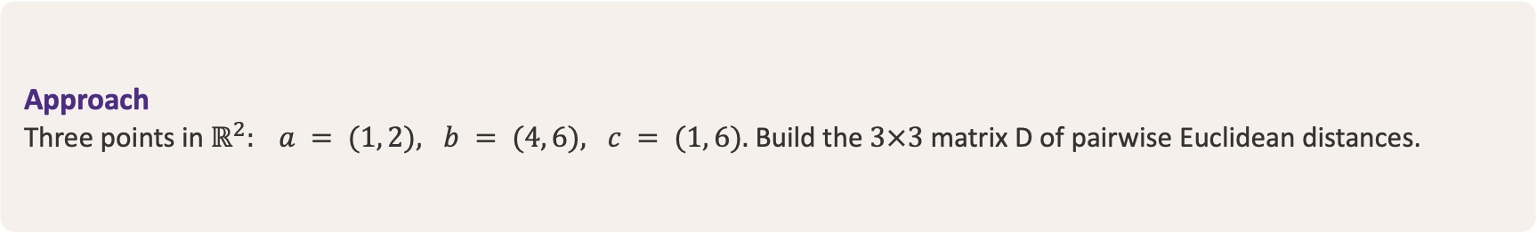
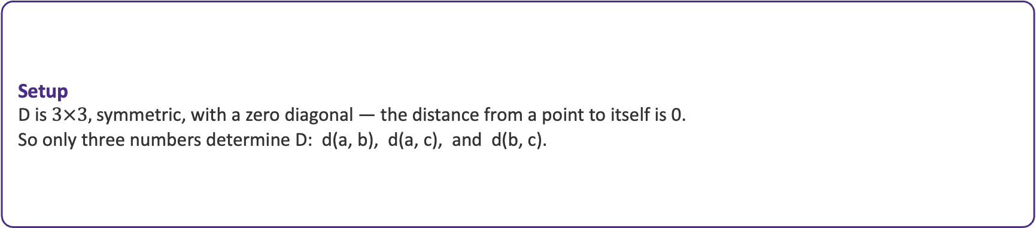
Exercise 1: Distance Matrix — Step 1
STEP 1 OF $3 ·$ Euclidean distance entries: $D_{ij}=\left\|p_{i}−p_{j}\right\|$
Approach
Three points in $ℝ^{2}: a = (1, 2), b = (4, 6), c = (1, 6).$ Build the $3×3$ matrix D of pairwise Euclidean distances.
Setup
D is $3×3,$ symmetric, with a zero diagonal — the distance from a point to itself is 0.
So only three numbers determine D: d(a, b), d(a, c), and d(b, c).

Slide 38
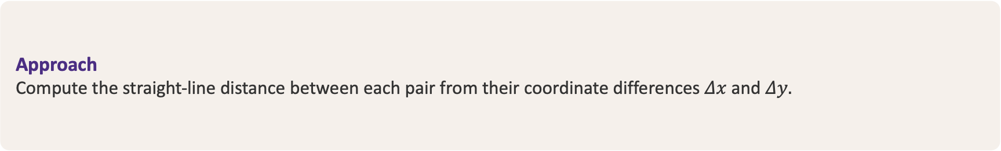

Exercise 1: Distance Matrix — Step 2
STEP 2 OF $3 ·$ Euclidean formula: $d=\sqrt{{Δx}^{2}+{Δy}^{2}}$
Approach
Compute the straight-line distance between each pair from their coordinate differences $Δx$ and $Δy.$
Work
$$d(a, b)=\sqrt{(4−1)² + (6−2)²}=\sqrt{9 + 16}=\sqrt{25}=5$$
$$d(a, c)=\sqrt{0² + (6−2)²}=\sqrt{16}=4$$
$$d(b, c)=\sqrt{(4−1)² + 0²}=\sqrt{9}=3$$

Slide 39
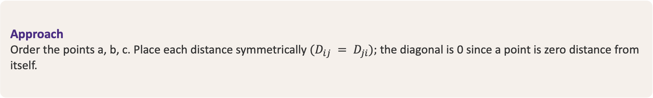

Exercise 1: Distance Matrix — Step 3
STEP 3 OF $3 ·$ Verify $D=D^{\text{T}}, diag(D)=0$
Approach
Order the points a, b, c. Place each distance symmetrically $(D_{ij} = D_{ji});$ the diagonal is 0 since a point is zero distance from itself.
Result
$$D=\left[\begin{matrix}0 & 5 & 4 \\ 5 & 0 & 3 \\ 4 & 3 & 0\end{matrix}\right]$$
Symmetric (D $= D^{T})$ with zero diagonal — a valid Euclidean distance matrix.

Slide 40
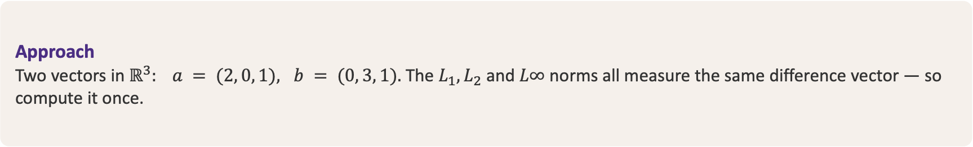

Exercise 2: Metric Comparison — Step 1
STEP 1 OF $3 ·$ every norm acts on the same difference $a−b$
Approach
Two vectors in $ℝ^{3}: a = (2, 0, 1), b = (0, 3, 1).$ The $L_{1}, L_{2}$ and $L∞$ norms all measure the same difference vector — so compute it once.
Work
$$a−b=(2−0, 0−3, 1−1)=(2, −3, 0)$$
This one vector feeds all three norm calculations.

Slide 41
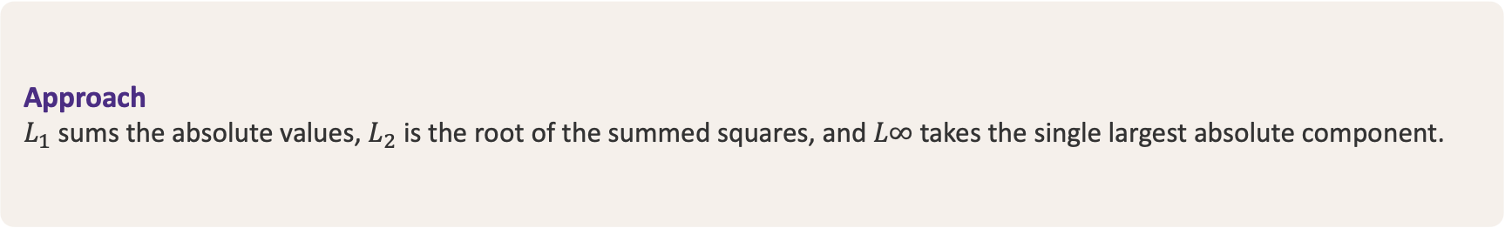

Exercise 2: Metric Comparison — Step 2
STEP 2 OF $3 · L_{1} = Σ|x_{i}| · L_{2} = \sqrt{}(Σ x_{i}^{2}) · L∞ = \text{max}|x_{i}|$
Approach
$L_{1}$ sums the absolute values, $L_{2}$ is the root of the summed squares, and $L∞$ takes the single largest absolute component.
Work
$${\left\|a−b\right\|}_{1}=|2| + |−3| + |0|=5$$
$${\left\|a−b\right\|}_{2}=\sqrt{2² + (−3)² + 0²}=\sqrt{13}≈3.61$$
$${\left\|a−b\right\|}_{∞}=max(|2|, |−3|, |0|)=3$$

Slide 42
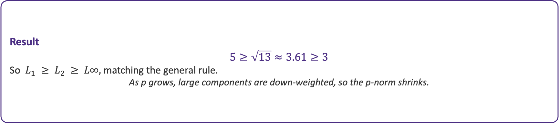
Exercise 2: Metric Comparison — Step 3
STEP 3 OF $3 ·$ General ordering: ${\left\|x\right\|}_{1}≥{\left\|x\right\|}_{2}≥{\left\|x\right\|}_{∞}$
Approach
Rank the three values from Step 2, then connect the result to the general norm inequality.
Result
$$5≥\sqrt{13}≈3.61≥3$$
So $L_{1} ≥ L_{2} ≥ L∞,$ matching the general rule.
As p grows, large components are down-weighted, so the p-norm shrinks.

Slide 43


Exercise 3: Standardization — Step 1
STEP 1 OF $3 ·$ Mean: $μ=\frac{1}{n}Σ_{i}{x_{i}}$
Approach
A single feature column with four values: x = (10, 20, 30, 40). Start by computing the mean $μ.$
Work
$$μ=\frac{10 + 20 + 30 + 40}{4}=\frac{100}{4}=25$$

Slide 44
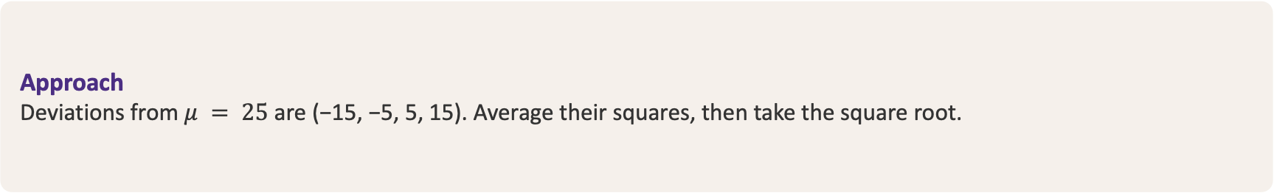

Exercise 3: Standardization — Step 2
STEP 2 OF $3 ·$ Population std-dev: $σ=\sqrt{\frac{1}{n}Σ_{i}{{\left(x_{i}−μ\right)}^{2}}}$
Approach
Deviations from $μ = 25$ are (−15, −5, 5, 15). Average their squares, then take the square root.
Work
$$σ=\sqrt{\frac{(−15)² + (−5)² + 5² + 15²}{4}}$$
$$=\sqrt{\frac{500}{4}}=\sqrt{125}=5\sqrt{5}≈11.18$$

Slide 45
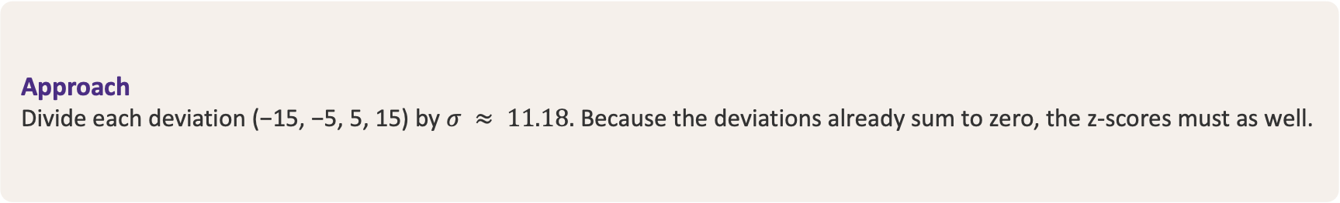

Exercise 3: Standardization — Step 3
STEP 3 OF $3 ·$ z-score: ${\tilde{x}}_{i}=\frac{x_{i}−μ}{σ}$
Approach
Divide each deviation (−15, −5, 5, 15) by $σ ≈ 11.18.$ Because the deviations already sum to zero, the z-scores must as well.
Result
$$\tilde{x}=\frac{(−15, −5, 5, 15)}{\sqrt{125}}≈(−1.34, −0.45, 0.45, 1.34)$$
$$Σ_{i}{{\tilde{x}}_{i}}=0$$
$Σ(x_{i} − μ) = Σx_{i} − nμ = 100 − 100 = 0,$ so the z-scores sum to zero.

Slide 46
01
K-Means Clustering
Centroid-based partitioning: minimizing within-cluster variance via Lloyd's algorithm in $ℝ^{d}$

Slide 47


K-Means: The Objective
K-means partitions the $n$ rows of $X$ into $k$ clusters by minimizing the total within-cluster sum of squares (WCSS), also called inertia:
$$J=\sum_{k}{\sum_{x_{i}∈C_{k}}{{{\left\|x_{i}−μ_{k}\right\|}_{2}}^{2}}}$$
$μ_{k}=\frac{1}{\left|C_{k}\right|}\sum_{i∈C_{k}}{x_{i}}$ is the centroid (mean vector) of cluster $k$.
$J$ is non-convex in the assignments — finding the global optimum is NP-hard.
Lloyd's algorithm minimizes $J$ by alternating two steps, each of which can only decrease $J$.

Slide 48
Lloyd's Algorithm: History & Intuition
From 1950s signal quantization to the workhorse of modern clustering.
A Bit of History
The Core Intuition
Devised by Stuart Lloyd at Bell Labs in 1957 to quantize signals for pulse-code modulation (PCM).
Circulated internally for years — formally published only in 1982.
Found independently by Forgy (1965); MacQueen (1967) coined the name “k-means.”
Pick k centroids, then alternate two cheap steps:
  Assign each point to its nearest centroid.
  Recompute each centroid as the mean of its points.
Every step lowers the within-cluster SSE — so it can only improve.
A form of coordinate descent: it hill-climbs to a local optimum.
Simple, fast, and guaranteed to converge — but only to a local optimum, so we run several random restarts.

Slide 49


Lloyd's Algorithm
Initialize centroids $μ_{1},…,μ_{k}$, then alternate until assignments stop changing:
1. Assignment Step
2. Update Step
Assign each point to its nearest centroid:
$$c\left(i\right)={\text{argmin}}_{k}{{\left\|x_{i}−μ_{k}\right\|}_{2}}^{2}$$
Fixes the binary assignment matrix $Z$. Cost: $\text{O}\left(n k d\right)$ / iter.
Recompute each centroid as the cluster mean:
$$μ_{k}=\frac{1}{\left|C_{k}\right|}\sum_{x_{i}∈C_{k}}{x_{i}}$$
The LA least-squares solution minimizing $\sum{{\left\|x_{i}−μ\right\|}^{2}}$. Cost: $\text{O}\left(n d\right)$ / iter.
Each step is non-increasing in $J$, so k-means converges to a local minimum in finitely many iterations. Restart from several initializations and keep the lowest $J$.

Slide 50


Lloyd's Algorithm
10
Step $0 ·$ Initialize centroids
8
Place k = 3 centroids $μ_{1}{, μ}_{2}{, μ}_{3}$ at starting positions. Every point is still unassigned — the two-step loop has not run yet.
6
4
Cluster 1
Cluster 2
2
Cluster 3
Centroid (cluster mean)
0
0
2
4
6
8
10

Slide 51


Lloyd's Algorithm
10
Step $1 ·$ Assignment (iteration 1)
8
Assign each point to its nearest centroid: $c_{i} = {\text{argmin}}_{k} {\left\|x_{i} − μ_{k}\right\|}^{2}$. Point colours now show the current cluster membership.
6
4
Cluster 1
Cluster 2
2
Cluster 3
Centroid (cluster mean)
0
0
2
4
6
8
10

Slide 52


Lloyd's Algorithm
10
Step $2 ·$ Update (iteration 1)
8
Move each centroid to the mean of its assigned points: $μk = (1/|C_{k}|)$ $Σ$ $x_{i}.$ Hollow markers show the previous centroid positions.
6
4
Cluster 1
Cluster 2
2
Cluster 3
New centroid
Previous centroid
0
0
2
4
6
8
10

Slide 53

Lloyd's Algorithm
10
Step $1 ·$ Assignment (iteration 2)
8
Re-assign every point to the nearest updated centroid. Memberships sharpen — the three clusters now separate cleanly.
6
4
Cluster 1
Cluster 2
2
Cluster 3
Centroid (cluster mean)
0
0
2
4
6
8
10

Slide 54

Lloyd's Algorithm
10
Step $2 ·$ Update (iteration 2) — converged
8
Centroids settle on the final cluster means. The next assignment would not change, so Lloyd's algorithm has converged to a local minimum of J.
6
4
Cluster 1
Cluster 2
2
Cluster 3
Final centroid
Previous centroid
0
0
2
4
6
8
10

Slide 55


Initialization: k-means++
Random initialization can place two centroids in the same true cluster, trapping Lloyd in a bad local minimum.
k-means++ spreads initial centroids using a probability proportional to squared distance from the nearest chosen centroid.
Guarantees expected cost within $\text{O}\left(\text{log} k\right)$ of the optimum — a provable approximation bound.
Standard default in scikit-learn (init='k-means++').
The procedure
Pick $μ_{1}$ uniformly at random from the rows of $X$.
For each $x_{i}$, let $D\left(x_{i}\right)={\text{min}}_{μ}{\left\|x_{i}−μ\right\|}_{2}$.
Choose the next centroid with probability $\frac{{D\left(x_{i}\right)}^{2}}{\sum_{j}{{D\left(x_{j}\right)}^{2}}}$.
Repeat until $k$ centroids are chosen, then run Lloyd.

Slide 56


Lloyd Iteration — Step 1: Assignment
STEP 1 OF 3
Assign each point to its nearest centroid
Compare every point to both centroids $μ_{1} = (1, 1)$ and $μ_{2} = (8, 8),$ and pick the smaller squared distance.
The three low points fall to cluster 1; the three high points fall to cluster 2.
Assignment
Cluster $1{ → μ}_{1}$
$$x_{1}=(1,1) x_{2}=(1,2) x_{3}=(2,1)$$
Cluster $2{ → μ}_{2}$
$$x_{4}=(8,8) x_{5}=(9,8) x_{6}=(8,9)$$

Slide 57

Lloyd Iteration — Step 2: Update Centroids
STEP 2 OF 3
Recompute each centroid as the cluster mean
Average the points assigned to each cluster, coordinate by coordinate.
Both centroids move toward the centre of their three points.
Update
Cluster 1
$μ_{1} =$ (1+1+2, 1+2+1) / 3
= (4, 4) / 3 = (1.33, 1.33)
Cluster 2
$μ_{2} =$ (8+9+8, 8+8+9) / 3
= (25, 25) / 3 = (8.33, 8.33)

Slide 58
Lloyd Iteration — Step 3: Inertia & Convergence
STEP 3 OF 3
Measure the within-cluster spread
Inertia J adds up the squared distance from every point to its own centroid.
Re-assigning with the updated centroids keeps every point in the same cluster, so the algorithm has converged in one iteration.
Inertia
Cluster 1 spread: 1.33
Cluster 2 spread: 1.33
J = 1.33 + 1.33 = 2.67
Assignments unchanged ⇒ converged

Slide 59


Matrix Form — Step 1: Stack the Data
STEP 1 OF 2
$$X=\left[\begin{matrix}1 & 1 \\ 1 & 2 \\ 2 & 1 \\ 8 & 8 \\ 9 & 8 \\ 8 & 9\end{matrix}\right]$$
Rows are data points
Stack the six observations $x_{1}…x_{6}$ as the rows of the data matrix X.
X is $6×2:$ six points, two features per point.
Each column is one feature dimension.

Slide 60


Matrix Form — Step 2: Stack the Centroids
STEP 2 OF 2
$$M^{(0)}=\left[\begin{matrix}1 & 1 \\ 8 & 8\end{matrix}\right]$$
Rows are centroids
Stack the two initial centroids $μ_{1} = (1, 1)$ and $μ_{2} = (8, 8)$ as the rows of $M^{(0)} (2×2).$
Cluster 1 = blue, cluster 2 = orange. We keep this colour coding throughout.
One row per cluster centre.

Slide 61


Distance Matrix — Step 1: The Formula
STEP 1 OF 3
$$D_{ik}={\left\|x_{i}−μ_{k}\right\|}^{2}$$
$$={\left(x_{i1}−μ_{k1}\right)}^{2}+{\left(x_{i2}−μ_{k2}\right)}^{2}$$
Every point to every centroid
Build $a 6×2$ matrix D. Entry D(i, k) is the squared Euclidean distance from point $x_{i}$ to centroid $μ_{k}.$
Column 1 measures distance to $μ_{1}$ (blue); column 2 to $μ_{2}$ (orange).
Smaller entry in a row = the nearer centroid.

Slide 62


Distance Matrix — Step 2: Compute Column 1
STEP 2 OF 3
$$D_{21}={\left(1−1\right)}^{2}+{\left(2−1\right)}^{2}=0+1=1$$
$$d(·, μ₁)={\left[\begin{matrix}0 & 1 & 1 & 98 & 113 & 113\end{matrix}\right]}^{T}$$
Distances to $μ_{1} = (1, 1)$
Set k = 1 and apply the formula to each point. For $x_{2} = (1, 2):$
Repeating for all six points fills column 1 of D.
Column 1 = squared distances to $μ_{1}.$

Slide 63


Distance Matrix — Step 3: Assemble D
STEP 3 OF 3
$$D=\left[\begin{matrix}0 & 98 \\ 1 & 85 \\ 1 & 85 \\ 98 & 0 \\ 113 & 1 \\ 113 & 1\end{matrix}\right]$$
All distances at once
Column 1 = distances to $μ_{1}$ (blue); column 2 = distances to $μ_{2}$ (orange).
The smaller value in each row (bold) marks the nearer centroid.
Bold entries preview the assignment in the next step.

Slide 64


Assignment — Step 1: Nearest Centroid (argmin)
STEP 1 OF 2
$$c_{i}={arg min}_{k}D_{ik}$$
$$c={\left[\begin{matrix}1 & 1 & 1 & 2 & 2 & 2\end{matrix}\right]}^{T}$$
Pick the nearest centroid
For each row of D, the assignment $c_{i}$ is the column index of the smaller squared distance — the nearer centroid.
Rows 1–3 $→$ cluster 1 (blue); rows 4–6 $→$ cluster 2 (orange).
c records each point’s cluster label.

Slide 65


Assignment — Step 2: One-Hot Matrix Z
STEP 2 OF 2
$$Z=\left[\begin{matrix}1 & 0 \\ 1 & 0 \\ 1 & 0 \\ 0 & 1 \\ 0 & 1 \\ 0 & 1\end{matrix}\right]$$
Encode labels as a binary matrix
Z is $6×2.$ Row i puts a 1 in the assigned column and 0 elsewhere — the one-hot code of $c_{i}.$
Each column sum is the cluster size: 3 and 3.
Z turns the assignment into linear algebra.

Slide 66



Update — Step 1: Cluster Sums $Z^{T}X$
STEP 1 OF 3
Each row of $Z^{T}$ picks its cluster’s points and adds them
$$Z^{T}X=\left[\begin{matrix}1 & 1 & 1 & 0 & 0 & 0 \\ 0 & 0 & 0 & 1 & 1 & 1\end{matrix}\right]\left[\begin{matrix}1 & 1 \\ 1 & 2 \\ 2 & 1 \\ 8 & 8 \\ 9 & 8 \\ 8 & 9\end{matrix}\right]=\left[\begin{matrix}4 & 4 \\ 25 & 25\end{matrix}\right]$$
Row 1 (blue) = [1 1 1 0 0 0] selects $x_{1},x_{2},x_{3} →$ sum (4, 4). Row 2 (orange) = [0 0 0 1 1 1] selects $x_{4},x_{5},x_{6} →$ sum (25, 25).

Slide 67


Update — Step 2: Cluster Sizes & Divide
STEP 2 OF 3
$Z^{T}1$ counts each cluster, then divide the sums
$$Z^{T}1=\left[\begin{matrix}3 \\ 3\end{matrix}\right] (cluster sizes)$$
$$M^{(1)}=\left[\begin{matrix}\frac{4}{3} & \frac{4}{3} \\ \frac{25}{3} & \frac{25}{3}\end{matrix}\right]$$
Each cluster has $N_{k} = 3$ points. Dividing row k of $Z^{T}X$ by $N_{k}$ gives the new centroid $μ_{k}.$

Slide 68


Update — Step 3: New Centroids $M^{(1)}$
STEP 3 OF 3
Each centroid moves to its cluster mean
$$M^{(0)}=\left[\begin{matrix}1 & 1 \\ 8 & 8\end{matrix}\right] → M^{(1)}=\left[\begin{matrix}1.33 & 1.33 \\ 8.33 & 8.33\end{matrix}\right]$$
Centroids shift toward their points. Re-running the assignment leaves every cluster unchanged — the iteration has converged.

Slide 69


Inertia — Step 1: Keep Each Point’s Own Distance
STEP 1 OF 2
Z ⊙ D keeps each point’s distance to its own centroid
$$Z⊙D^{(1)}=\left[\begin{matrix}0.22 & 0 \\ 0.56 & 0 \\ 0.56 & 0 \\ 0 & 0.22 \\ 0 & 0.56 \\ 0 & 0.56\end{matrix}\right]$$
The element-wise product masks D with Z: where Z = 1 the squared distance (to the updated centroid $M^{(1)})$ is kept; everywhere else it becomes 0.

Slide 70


Inertia — Step 2: Sum to Get J
STEP 2 OF 2
Add every kept entry $→$ total inertia J
$$J=\left(0.22 + 0.56 + 0.56\right)+\left(0.22 + 0.56 + 0.56\right)=1.33+1.33=2.67$$
Each cluster contributes 1.33. Re-running assignment with $M^{(1)}$ leaves Z unchanged — the iteration has converged.

Slide 71

Example 2: Choosing k (Elbow)
EXAMPLE
Task
Run k-means for $k=1…6$ and plot inertia $J\left(k\right)$. Pick the 'elbow' where marginal gain drops.
Reading the curve
$J\left(k\right)$ always decreases as $k$ grows.
The elbow at $k=3$ is where adding clusters stops cutting $J$ sharply.
Beyond the elbow, extra clusters only split noise.

Slide 72


Example 3: Scaling Changes Clusters
EXAMPLE
Raw features
Age (20–60) and Income ($20k–$120k).
$$d=\sqrt{{\left(\text{Δage}\right)}^{2}+{\left(\text{Δincome}\right)}^{2}}$$
Income spans ~100,000 while age spans ~40. The squared income term dominates the norm — clusters split almost entirely on income.
Standardized (z-score)
Each column rescaled to $μ=0$, $σ=1$.
$$\tilde{x}=\frac{\left(x−μ\right)}{σ}$$
Both features now contribute equally to ${\left\|\text{·}\right\|}_{2}$. Clusters reflect joint age–income structure. Always standardize before a Euclidean k-means.

Slide 73

K-Means — Exercises
E1
Two iterations. Points $x_{1}=\left(0,0\right)$, $x_{2}=\left(1,0\right)$, $x_{3}=\left(5,5\right)$, $x_{4}=\left(6,5\right)$, $k=2$, init $μ_{1}=\left(0,0\right)$, $μ_{2}=\left(1,0\right)$. Run Lloyd to convergence and give final centroids and $J$.
E2
Bad initialization. Using the same data, show that init $μ_{1}=\left(0,0\right)$, $μ_{2}=\left(1,0\right)$ can converge to a worse local optimum than $μ_{1}=\left(0,0\right)$, $μ_{2}=\left(6,5\right)$. Compare both $J$ values.
E3
k-means++ probabilities. Given chosen $μ_{1}=\left(0,0\right)$ and points at distances $D=\left(0,2,7,8\right)$, compute the selection probability $\frac{D^{2}}{\sum{D^{2}}}$ for each remaining point.

Slide 74
02
Hierarchical Clustering
Agglomerative merging, linkage criteria, and the dendrogram — a nested family of partitions

Slide 75


Agglomerative Clustering
Agglomerative = bottom-up. Start with each of the $n$ points as its own singleton cluster.
Repeatedly merge the two closest clusters until one cluster remains.
Produces a full hierarchy of $n$ nested partitions — no need to pre-specify $k$.
Cut the hierarchy at any height to obtain a flat clustering.
Driven entirely by the distance matrix $D$ and a linkage rule.
Algorithm
Compute $D∈ℝ^{n×n}$ from $X$.
Each point is its own cluster: $\left|C\right|=n$.
Find the pair $\left(C_{a},C_{b}\right)$ minimizing linkage distance.
Merge them; update $D$ for the new cluster.
Repeat $n−1$ times, recording merge heights.
Cost: $\text{O}\left(n^{3}\right)$ naive, $\text{O}\left(n^{2} \text{log} n\right)$ with priority queues.

Slide 76




Types of Linkage
Single (min)
Complete (max)
$$d\left(A,B\right)=\text{min}\left\|x_{i}−x_{j}\right\|, i∈A, j∈B$$
Nearest pair across clusters. Finds elongated, chain-like clusters but suffers from chaining.
$$d\left(A,B\right)=\text{max}\left\|x_{i}−x_{j}\right\|, i∈A, j∈B$$
Farthest pair. Produces compact, roughly equal-diameter clusters; sensitive to outliers.
Average (UPGMA)
Ward (variance)
$$d\left(A,B\right)=\frac{1}{\left|A\right|\left|B\right|}\sum{\left\|x_{i}−x_{j}\right\|}$$
Mean of all cross-pair distances. A balanced compromise between single and complete.
$$\text{Δ}=\frac{\left|A\right|\left|B\right|}{\left|A\right|+\left|B\right|}{\left\|μ_{A}−μ_{B}\right\|}^{2}$$
Merge that minimizes the increase in within-cluster variance. Tends to give spherical clusters.

Slide 77

The Dendrogram
A dendrogram is a binary tree recording the full merge sequence.
Leaves are the $n$ singleton points; the root is the single all-inclusive cluster.
Each merge is drawn at a height equal to the linkage distance at which it occurred.
Cutting horizontally at a chosen height yields a flat clustering — the number of vertical lines crossed $=k$.
Long vertical edges signal well-separated clusters; short ones signal weak structure.
height = merge distance
cut → 3 clusters
A
B
C
D
E

Slide 78

Updating Distances: Lance–Williams
$$d\left(C,A∪B\right)=α_{a} d\left(C,A\right)+α_{b} d\left(C,B\right)+β d\left(A,B\right)+γ \left|d\left(C,A\right)−d\left(C,B\right)\right|$$
A single recurrence updates $D$ after each merge — coefficients $\left(α_{a},α_{b},β,γ\right)$ define the linkage:
Linkage | $$α_{a}$$ | $$α_{b}$$ | $$β$$ | $$γ$$
Single | $$\frac{1}{2}$$ | $$\frac{1}{2}$$ | $$0$$ | $$−\frac{1}{2}$$
Complete | $$\frac{1}{2}$$ | $$\frac{1}{2}$$ | $$0$$ | $$+\frac{1}{2}$$
Average | $$\frac{\left|A\right|}{\left(\left|A\right|+\left|B\right|\right)}$$ | $$\frac{\left|B\right|}{\left(\left|A\right|+\left|B\right|\right)}$$ | $$0$$ | $$0$$
Ward | $$\frac{\left|A\right|+\left|C\right|}{T}$$ | $$\frac{\left|B\right|+\left|C\right|}{T}$$ | $$−\frac{\left|C\right|}{T}$$ | $$0$$

Slide 79


Example 1: Single-Linkage by Hand
EXAMPLE
Distance matrix over points A, B, C, D:
$$D=\left[\begin{matrix}0 & 2 & 6 & 10 \\ 2 & 0 & 5 & 9 \\ 6 & 5 & 0 & 4 \\ 10 & 9 & 4 & 0\end{matrix}\right]$$
Build the single-linkage hierarchy and give merge heights.
Solution
Min entry = 2 → merge $\left\{\text{A},\text{B}\right\}$ at height 2.
Update (single = min): $d\left(\text{AB},\text{C}\right)=\text{min}\left(6,5\right)=5$; $d\left(\text{AB},\text{D}\right)=\text{min}\left(10,9\right)=9$.
Now min = 4 → merge $\left\{\text{C},\text{D}\right\}$ at height 4.
$d\left(\text{AB},\text{CD}\right)=\text{min}\left(d\left(\text{AB},\text{C}\right),d\left(\text{AB},\text{D}\right)\right)=5$
Merge $\left\{\text{AB}\right\}$, $\left\{\text{CD}\right\}$ at height 5 → root.
Order: (AB)@2, (CD)@4, root@5.

Slide 80

Example 2: Ward vs Single Linkage
EXAMPLE
Single linkage
Ward linkage
Merge criterion: nearest single pair across clusters.
On two interlocking crescents, follows the local chain — recovers the non-convex moons.
Vulnerable to a single bridging point that chains two true clusters together.
Cluster sizes can be very unbalanced.
Merge criterion: minimize increase in total within-cluster variance $\sum{{\left\|x_{i}−μ\right\|}^{2}}$.
On the same moons, cuts straight across — prefers compact, spherical blobs.
Robust to chaining; resistant to single bridging points.
Tends to produce balanced, similar-size clusters.

Slide 81


Example 3: Cophenetic Correlation
EXAMPLE
The cophenetic distance $c\left(i,j\right)$ is the merge height at which points $i$ and $j$ first join the same cluster.
The cophenetic correlation measures how faithfully the dendrogram preserves the original distances:
$$\text{CCC}=\text{corr}\left(\text{vec}\left(D\right),\text{vec}\left(C\right)\right)$$
where $D$ = original distances, $C$ = cophenetic distances (both flattened over the $\frac{n\left(n−1\right)}{2}$ pairs).
Interpretation
Using Example 1 heights:
$c\left(\text{A},\text{B}\right)=2$ $c\left(\text{C},\text{D}\right)=4$
$$c\left(\text{A},\text{C}\right)=c\left(\text{A},\text{D}\right)=c\left(\text{B},\text{C}\right)=c\left(\text{B},\text{D}\right)=5$$
Pearson-correlate these 6 cophenetic values against the 6 original distances $\left\{2,6,10,5,9,4\right\}$.
$\text{CCC}≈0.96$ here — close to 1 means the tree is a trustworthy summary of $D$. Use it to compare linkages.

Slide 82

Hierarchical — Exercises
E1
Complete linkage. Repeat the Example 1 distance matrix $\left\{d\left(\text{A},\text{B}\right)=2, \text{A}–\text{C}=6, \text{A}–\text{D}=10, \text{B}–\text{C}=5, \text{B}–\text{D}=9, \text{C}–\text{D}=4\right\}$ but use COMPLETE linkage. Give the merge order and heights.
E2
Lance–Williams check. Verify that the single-linkage update $d\left(\text{AB},\text{C}\right)=5$ follows from the Lance–Williams formula with $α_{a}=α_{b}=\frac{1}{2}$, $β=0$, $γ=−\frac{1}{2}$.
E3
Cut the tree. Given a dendrogram with merge heights $\left\{2,4,5,9\right\}$, state how many clusters result from a horizontal cut at height 4.5 and at height 6.

Slide 83


E1 Solution — Step 1: First Merge (Complete Linkage)
Recall the distance matrix over A, B, C, D
d(A,B) = 2 d(A,C) = 6 d(A,D) = 10 d(B,C) = 5 d(B,D) = 9 d(C,D) = 4
Step $1 ·$ Find the smallest entry
Smallest distance = d(A,B) = 2
Merge {A, B} at height 2.
Same first merge as single linkage — the linkage rule only changes what happens next.
Complete-linkage update $·$ take the max
d(AB, C) = max(6, 5) = 6
d(AB, D) = max(10, 9) = 10
Complete linkage measures the farthest pair between clusters, so each update keeps the larger value.
Active clusters: {A,B}, {C}, {D} with d(AB,C) = 6, d(AB,D) = 10, d(C,D) = 4

Slide 84

E1 Solution — Step 2: Second Merge
Distances after the first merge
d(AB, C) = 6 d(AB, D) = 10 d(C, D) = 4
Step $2 ·$ Smallest remaining distance
Smallest distance = d(C, D) = 4
Merge {C, D} at height 4.
C and D are each other's nearest neighbours, so they join before anything reaches {A,B}.
Update with the max rule
d(AB, CD) = max(6, 10) = 10
The union {C,D} inherits the larger of d(AB,C) and d(AB,D) — that is the farthest-pair distance A–D = 10.
Active clusters: {A,B}, {C,D} with a single remaining distance d(AB, CD) = 10

Slide 85

E1 Solution — Step 3: Root Merge and Comparison
Step $3 ·$ Final merge
Only one distance is left: d(AB, CD) $= 10 →$ merge {A,B} with {C,D} at height 10 (root).
Answer — complete linkage
1. {A, B} at height 2
2. {C, D} at height 4
3. root at height 10
Compare with single linkage
Single: 2, 4, 5 (root)
Complete: 2, 4, 10 (root)
Same merge order, very different heights: single linkage uses the nearest pair (B–C = 5), complete linkage the farthest (A–D = 10).
Complete linkage stretches the dendrogram upward — it resists chaining but splits elongated clusters.

Slide 86



E2 Solution — Step 1: The Lance–Williams Formula
Exercise E2
Show that the single-linkage update d(AB, C) = 5 follows from Lance–Williams with $α_{1}{ = α}_{2} =$ ½, $β = 0, γ =$ −½.
Step $1 ·$ The Lance–Williams recurrence
d(AB, C) ${= α}_{1}$ d(A,C) ${+ α}_{2}$ d(B,C) $+ β$ d(A,B) $+ γ$ |d(A,C) − d(B,C)|
One recurrence covers every linkage — only the four coefficients change.
Why this coefficient set means "nearest pair"
½(x + y) − ½|x − y| = min(x, y)
With $α_{1}{ = α}_{2} =$ ½, $β = 0$ and $γ =$ −½ the recurrence collapses to the minimum of the two distances — exactly the single-linkage rule.

Slide 87

E2 Solution — Step 2: Substitute and Simplify
Values from the Example 1 matrix
d(A,C) = 6 d(B,C) = 5 d(A,B) = 2
Step $2 ·$ Substitute
d(AB,C) = ½(6) + ½(5) + 0(2) − ½|6 − 5|
Each coefficient is applied to its own distance; the last term uses the absolute difference.
Simplify
= 3 + 2.5 − 0.5 = 5
= min(6, 5) — the single-linkage update, verified.
Flip one coefficient to change the linkage: $γ =$ +½ gives complete linkage (max), and weights $α_{1} = n_{1}/(n_{1}+n_{2}{), α}_{2} = n_{2}/(n_{1}+n_{2})$ with $β = γ = 0$ give average linkage.

Slide 88

E3 Solution — Step 1: How a Horizontal Cut Works
Exercise E3
A dendrogram over 5 points has merge heights 2, 4, 5, 9. How many clusters does a horizontal cut give at height 4.5, and at 6?
Step $1 ·$ What a horizontal cut does
A cut at height h accepts every merge whose height $≤ h$ and rejects the rest.
Each accepted merge joins two groups, so it lowers the cluster count by exactly one.
clusters(h) = n − #{merges with height $≤$ h}
With n = 5 leaves and 4 merges the count steps down $5 → 4 → 3 → 2 → 1$ as h rises past 2, 4, 5 and 9.

Slide 89


E3 Solution — Step 2: Cuts at Height 4.5 and 6
Merge heights
2, 4, 5, 9 (n = 5 points, 4 merges)
Cut at h = 4.5
Merges accepted: 2 and $4 → 2$ merges
clusters = 5 − 2 = 3
The merges at 5 and 9 sit above the cut and are ignored.
Cut at h = 6
Merges accepted: 2, 4 and $5 → 3$ merges
clusters = 5 − 3 = 2
Only the root merge at 9 remains above the line.
Answer: 3 clusters at h = 4.5, 2 clusters at h = 6.
The wide gap between 5 and 9 is the tallest jump in the tree — that is the cut most people would defend.

Slide 90



End-to-End Example: Five Points and the Data Matrix
Five points in $ℝ^{2}$
A = (0, 0) B = (2, 0) C = (6, 0) D = (6, 3) E = (0, 5)
Stack the observations as rows
$X = \left[\begin{matrix}0 & 0 \\ 2 & 0 \\ 6 & 0 \\ 6 & 3 \\ 0 & 5\end{matrix}\right]$
Rows are the points A to E, columns are the coordinates — X is $5 × 2.$
The route we will follow
$G = XX^{T}$ — one matrix product
$D_{ij}^{2} = G_{ii} + G_{jj} − 2G_{ij}$
Entrywise square roots give D
Single-linkage merges, then the dendrogram

Slide 91




Step 1: Gram Matrix $G = XX^{T}$
One product gives every inner product
$G = XX^{T},$ so $G_{ij} = x_{i}^{T}x_{j}$ — X is $5 × 2,$ hence G is $5 × 5.$
Step $1 ·$ The Gram matrix (order A, B, C, D, E)
$G = \left[\begin{matrix}0 & 0 & 0 & 0 & 0 \\ 0 & 4 & 12 & 12 & 0 \\ 0 & 12 & 36 & 36 & 0 \\ 0 & 12 & 36 & 45 & 15 \\ 0 & 0 & 0 & 15 & 25\end{matrix}\right]$
Read the diagonal
g = diag(G) = (0, 4, 36, 45, 25)
These are the squared norms of each point. Check $D: 6^{2} + 3^{2} = 45.$
Off-diagonal example: $C·D = 6·6 + 0·3 = 36,$ and $B·E = 2·0 + 0·5 = 0.$

Slide 92



Step 2: Squared Distances by the Gram Trick
The Gram trick
$D_{ij}^{2} = G_{ii} + G_{jj} − 2G_{ij}$ (matrix form: $D^{2} = g1^{T} + 1g^{T} −$ 2G, with g = diag(G))
Step $2 ·$ Squared distances
$D² = \left[\begin{matrix}0 & 4 & 36 & 45 & 25 \\ 4 & 0 & 16 & 25 & 29 \\ 36 & 16 & 0 & 9 & 61 \\ 45 & 25 & 9 & 0 & 40 \\ 25 & 29 & 61 & 40 & 0\end{matrix}\right]$
Spot-check two entries
$D^{2}(B,D) = 4 + 45 −$ 2(12) = 25
$D^{2}(C,E) = 36 + 25 −$ 2(0) = 61
Symmetric with a zero diagonal, and still no square roots — everything so far is one product plus additions.

Slide 93



Step 3: The Euclidean Distance Matrix 𝐃
Step $3 ·$ Take entrywise square roots
$D_{ij}$ is the square root of $D_{ij}^{2}$ — values below are rounded to two decimals.
Euclidean distance matrix (A, B, C, D, E)
$D = \left[\begin{matrix}0 & 2 & 6 & 6.71 & 5 \\ 2 & 0 & 4 & 5 & 5.39 \\ 6 & 4 & 0 & 3 & 7.81 \\ 6.71 & 5 & 3 & 0 & 6.32 \\ 5 & 5.39 & 7.81 & 6.32 & 0\end{matrix}\right]$
What single linkage will use
Three smallest pairs: d(A,B) = 2, d(C,D) = 3, d(B,C) = 4
Only the ordering of distances matters, so rounding never changes the tree.
Exact values: d(A,D) $= \sqrt{45},$ d(B,E) $= \sqrt{29},$ d(C,E) $= \sqrt{61},$ d(D,E) $= \sqrt{40}.$

Slide 94


Step 4: Merge 1 — Nearest Pair at Height 2
Scan D for the smallest off-diagonal entry
d(A,B) = 2 is the minimum (next smallest are d(C,D) = 3 and d(B,C) = 4).
Merge $1 ·$ height 2
Join {A} and {B} at height 2.
A = (0,0) and B = (2,0) are the closest pair in the plane.
Single-linkage update $·$ take the min
d(AB, C) = min(6, 4) = 4
d(AB, D) = min(6.71, 5) = 5
d(AB, E) = min(5, 5.39) = 5
Active clusters: {A,B}, {C}, {D}, {E} — four clusters, three merges to go.

Slide 95

Step 5: Merge 2 — Height 3
Distances after merge 1
d(AB,C) = 4 d(AB,D) = 5 d(AB,E) = 5 d(C,D) = 3 d(C,E) = 7.81 d(D,E) = 6.32
Merge $2 ·$ height 3
Smallest is d(C,D) $= 3 →$ join {C} and {D}.
C = (6,0) and D = (6,3) sit three units apart on the same vertical line.
Update the merged row
d(CD, AB) = min(4, 5) = 4
d(CD, E) = min(7.81, 6.32) = 6.32
Active clusters: {A,B}, {C,D}, {E} — three clusters left.

Slide 96

Step 6: Merge 3 — Height 4
Distances after merge 2
d(AB, CD) = 4 d(AB, E) = 5 d(CD, E) = 6.32
Merge $3 ·$ height 4
Smallest is d(AB, CD) $= 4 →$ join {A,B} with {C,D}.
That 4 is the original distance B–C: single linkage always merges at a distance that exists in D.
Update against the last singleton
d(ABCD, E) = min(5, 6.32) = 5
E keeps the smaller of its two links, which is d(A,E) = 5.
Active clusters: {A,B,C,D}, {E} — one merge left.

Slide 97

Step 7: Merge 4 — Root at Height 5
One distance remains
d(ABCD, E) = 5
Merge $4 ·$ height 5 (root)
E joins the rest at height 5 — the hierarchy is complete.
Four merges for five points, exactly as expected.
Merge order and heights
1. {A,B} at 2
2. {C,D} at 3
3. {A,B} + {C,D} at 4
4. root with E at 5
Every height is an original entry of D: 2 = d(A,B), 3 = d(C,D), 4 = d(B,C), 5 = d(A,E) — a property unique to single linkage.

Slide 98
Step 8: Sketching the Dendrogram
Single-linkage dendrogram — merge heights 2, 3, 4, 5
5
4
Cut at height 4.5
Three merges sit below the line, so 5 − 3 = 2 clusters: {A,B,C,D} and {E}.
3
2
A
B
C
D
E

Slide 99
03
DBSCAN
Density-Based Spatial Clustering of Applications with Noise

Slide 100

Reading the Notation: Neighbourhoods and Core Points
$N_{ε} (x) =$ { x′ $∈ X$ : $\left\|x − x′\right\| ≤ ε$ } x is core ⇔ $|N_{ε}(x)| ≥$ MinPts
Piece by piece: the $ε−\text{neighbourhood}$
$N_{ε}(x)$ is read "the $ε−\text{neighbourhood}$ of x" — the points near x.
{ x′ $∈ X$ : … } means "all points x′ in the data set X for which …".
$\left\|x − x′\right\| ≤ ε$ means "the distance from x to x′ is no more than $ε".$
Piece by piece: the core condition
The bars |…| count how many points are in the set — a count, not a distance.
⇔ means "exactly when": this is the definition of a core point.
So x is core when its circle holds at least MinPts points.
In plain English: draw a circle of radius $ε$ around x. If it contains at least MinPts points — counting x itself — then x sits in a dense region and is called a core point.

Slide 101


The DBSCAN Algorithm, Step by Step
Two inputs, and no $k: ε$ — the radius that defines "nearby". MinPts — how many neighbours make a neighbourhood dense.
The algorithm
$1 ·$ For every point x, count the points within $ε$ of it — that count is $|N_{ε}(x)|.$
$2 ·$ Mark x as core if the count reaches MinPts.
$3 ·$ Join two core points into the same cluster whenever one lies within $ε$ of the other.
$4 ·$ Attach each non-core point that sits within $ε$ of a core to that core's cluster — these are border points.
$5 ·$ Anything still unattached is labelled noise.
What this buys you
The number of clusters is discovered, not chosen
Clusters may be any shape — density, not distance to a centre
Outliers are an output, not a nuisance
Cost: one $ε−\text{range}$ query per point — about O(n log n) with a spatial index, $O(n^{2})$ without.

Slide 102



Density: Core, Border & Noise
$N_{ε}\left(x\right)=\left\{x′∈X:\left\|x−x′\right\|≤ε\right\}$ $x \text{is} \text{core} ⇔ \left|N_{ε}\left(x\right)\right|≥\text{MinPts}$
Core point
Border point
Noise point
$$\left|N_{ε}\left(x\right)\right|≥\text{MinPts}$$
Has at least MinPts points (including itself) within distance $ε$. Cores seed and grow clusters.
$$\left|N_{ε}\left(x\right)\right|<\text{MinPts}$$
$$∃ \text{core} q: x∈N_{ε}\left(q\right)$$
Not dense itself, but lies within $ε$ of a core point. Joins that core's cluster on the edge.
$$\left|N_{ε}\left(x\right)\right|<\text{MinPts}$$
$$∄ \text{core} \text{within} ε$$
Neither core nor reachable from any core. Labelled noise / outlier — left unclustered.

Slide 103


DBSCAN Algorithm
Pick an unvisited point $x$; compute $N_{ε}\left(x\right)$.
If $\left|N_{ε}\left(x\right)\right|<\text{MinPts}$, mark $x$ noise (may be reclaimed later).
Else start a new cluster; add all of $N_{ε}\left(x\right)$ to a queue.
Pop each $q$ from queue: if $q$ is core, append $N_{ε}\left(q\right)$ to the queue.
Repeat until queue empties — the cluster is fully expanded.
Continue until every point is visited.
Reachability
Directly density-reachable
$$p←q \text{if} p∈N_{ε}\left(q\right), q \text{core}$$
Density-reachable
chain $q=o_{1}→…→o_{k}=p$
each step directly reachable
Density-connected
$$∃ o: o→p \text{and} o→q$$
basis of a DBSCAN cluster

Slide 104

Example 1: Point Classification
EXAMPLE
Setup
$$X=\{\text{A}\left(1,1\right),\text{B}\left(1,2\right),\text{C}\left(2,1\right),\text{D}\left(8,8\right),\text{E}\left(8,9\right),\text{F}\left(25,25\right)\}$$
Parameters: $ε=2$, $\text{MinPts}=3$
Task
Using the ${\text{L}}_{2}$ norm, classify every point as core, border, or noise.
The next five slides work through the solution one step at a time.
The six points, drawn to scale
dashed circle = radius ε around A
F
20
10
D, E
A, B, C
10
20

Slide 105



Solution — Step 1: Neighbourhoods of A, B and C
Setup
X = {A(1,1), B(1,2), C(2,1), D(8,8), E(8,9), F(25,25)} $ε = 2,$ MinPts = 3
Step $1 ·$ Distances inside the tight group
d(A,B) = 1
d(A,C) = 1
d(B,C) $= \sqrt{2} ≈ 1.41$
All three are below $ε = 2,$ so each point falls inside the others' circles.
The resulting neighbourhoods
$N_{ε}(A) =$ {A, B, C}
$N_{ε}(B) =$ {A, B, C}
$N_{ε}(C) =$ {A, B, C}
Each set has 3 members — the point itself always counts.

Slide 106



Solution — Step 2: A, B and C are Core Points
Counts from Step 1
$|N_{ε}(A)| = |N_{ε}(B)| = |N_{ε}(C)| = 3$ MinPts = 3
Step $2 ·$ Apply the core test
$3 ≥ 3$ holds for A, B and C
A, B and C are all CORE points.
The test is "at least MinPts", so hitting the threshold exactly is enough.
Cores within $ε$ of each other merge
A, B and C are mutually inside $ε$
They form one cluster: Cluster 1 = {A, B, C}
Still to classify: D, E and F.

Slide 107



Solution — Step 3: Are D and E Dense Enough?
Turn to D(8,8) and E(8,9)
d(D,E) = 1, comfortably inside $ε = 2$ — so they do see each other.
Step $3 ·$ Their neighbourhoods
$N_{ε}(D) =$ {D, E}$N_{ε}(E) =$ {D, E}
$|N_{ε}| = 2 < 3 =$ MinPts
Neither D nor E is a core point.
Could they be border points?
Nearest core is C: d(C,D) $= \sqrt{85} ≈ 9.22$
Far beyond $ε = 2,$ so no core reaches them
D and E are NOISE.
Being close to one other point is not enough: DBSCAN asks for MinPts neighbours, or a core within reach.

Slide 108



Solution — Step 4: F, an Isolated Point
Finally F(25,25)
Its closest neighbour is E: d(E,F) $= \sqrt{({17}^{2} + {16}^{2})} ≈ 23.35$ — nothing else is anywhere near.
Step $4 ·$ Its neighbourhood
$N_{ε}(F) =$ {F}
$|N_{ε}(F)| = 1 < 3 =$ MinPts
F is not a core point.
And no core is within reach
Every other point is more than 23 away, versus $ε = 2$
F is NOISE — a genuine outlier.
This is the case DBSCAN handles better than k-means: F is reported as noise instead of being forced into a cluster.

Slide 109



Solution — Step 5: Final Labelling
Every point, with its verdict
$A: |N_{ε}| = 3 →$ CORE $B: |N_{ε}| = 3 →$ CORE $C: |N_{ε}| = 3 →$ CORE
$D: |N_{ε}| = 2 →$ NOISE $E: |N_{ε}| = 2 →$ NOISE $F: |N_{ε}| = 1 →$ NOISE
Step $5 ·$ Final answer
Cluster 1 = {A, B, C}
Noise = {D, E, F}
Why only one cluster
At $ε = 2$ with MinPts = 3, only the A–B–C corner is dense enough to seed a cluster.
No point qualified as a border point in this example.
Parameter check: with MinPts = 2 the pair {D, E} would become a second cluster, and F would still be noise — DBSCAN's output depends on both $ε$ and MinPts.

Slide 110


Example 2: Choosing $ε$ (k-distance)
EXAMPLE
Method
Fix $k=\text{MinPts}−1$. For each point compute the distance to its $k$-th nearest neighbour:
$$d_{k}\left(x_{i}\right)=\left\|x_{i}−x_{\left(k\right)}\right\|$$
Sort $d_{k}$ descending and plot. The 'knee' (point of maximum curvature) marks the $ε$ that separates dense interiors from sparse tails.
Read-off
Here the curve bends sharply at $ε≈0.9$ — use that as $ε$.

Slide 111



Example 3: Non-Convex Shapes
EXAMPLE
Setup
Two concentric rings in $ℝ^{2}$ — an inner disk surrounded by an outer annulus, same centre.
Why k-means fails
Minimises ${\left\|x−μ_{k}\right\|}^{2}$ ⇒ convex (Voronoi) cells.
No hyperplane separates nested rings — it splits them by angle.
Why DBSCAN works
Each ring is density-connected within itself.
Gaps between rings exceed $ε$ ⇒ distinct clusters.
k-means ($k=2$)
DBSCAN
k-means cuts by a linear boundary ($\left\|x−μ\right\|$); DBSCAN follows density, recovering each ring.

Slide 112
DBSCAN — Exercises
E1
E1 Given $X=\{\left(0,0\right),\left(0,1\right),\left(1,0\right),\left(1,1\right),\left(5,5\right)\}$ with $ε=1.5$, $\text{MinPts}=3$, label each point core / border / noise using the ${\text{L}}_{2}$ norm.
E2
E2 A point $p$ has $\left|N_{ε}\left(p\right)\right|=2<\text{MinPts}$ but lies within $ε$ of a core $q$. Prove $p$ is a border point and assign its cluster. State the reachability definition you use.
E3
E3 Explain, using ${\left\|x−μ_{k}\right\|}^{2}$ vs density-connectivity, why DBSCAN finds two clusters on concentric rings while k-means ($k=2$) cannot. When would DBSCAN itself fail?

Slide 113




E1 Solution — Step 1: The Neighbourhoods
Setup
X = {(0,0), (0,1), (1,0), (1,1), (5,5)} $ε = 1.5,$ MinPts = 3
Step $1 ·$ Measure inside the square
Side = 1, diagonal $= \sqrt{2} ≈ 1.41$
Both are $≤ ε = 1.5,$ so even the diagonal pairs are neighbours.
The five points
(5,5)
The neighbourhoods
Each corner: $|N_{ε}| = 4$ (itself + three others)
(5,5): nearest point is $\sqrt{32} ≈ 5.66$ away $→ |Nε| = 1$
unit square
dashed circle $= ε$ around (0,0)

Slide 114



E1 Solution — Step 2: The Core Test
Counts from Step 1
$(0,0), (0,1), (1,0), (1,1): |N_{ε}| = 4$ each $(5,5): |N_{ε}| = 1$ MinPts = 3
Step $2 ·$ Apply the core test
$4 ≥ 3 →$ all four corner points are CORE
Every corner clears MinPts on its own.
Four cores form one cluster
(5,5) still to classify
Cores that see each other merge
The four cores are mutually within $ε$
Cluster 1 = {(0,0), (0,1), (1,0), (1,1)}
all four are core

Slide 115



E1 Solution — Step 3: The Outlier and Final Labels
The remaining point (5,5)
Distance to its nearest neighbour $(1,1) = \sqrt{32} ≈ 5.66,$ far beyond $ε = 1.5.$
Step $3 ·$ Not core, not border
$|N_{ε}| = 1 < 3,$ and no core lies within $ε$
(5,5) is NOISE.
One cluster, one outlier
noise
Final labels
Core: (0,0), (0,1), (1,0), (1,1)
Border: none Noise: (5,5)
Cluster 1
The diagonal check matters: had $ε$ been 1.2, the diagonals would fail and each corner would see only 3 points — still core here, but the cluster shape changes.

Slide 116


E2 Solution — Step 1: The Definitions You Need
What we are given
p has $|N_{ε}(p)| = 2 <$ MinPts, and p lies within $ε$ of a core point q.
Step $1 ·$ The definitions to quote
q is core when $|N_{ε}(q)| ≥$ MinPts.
p is directly density-reachable from q when $p ∈N_{ε}(q)$ and q is core.
p is a border point when it is not core, yet is directly density-reachable from some core.
q is dense, p is not
p (border)
q (core)
Reachability is one-way: it is only defined out of core points, so p is reachable from q but not q from p.
p's own circle holds only p and q

Slide 117


E2 Solution — Step 2: The Proof and Cluster Assignment
Goal
Show that p is a border point, and state which cluster it joins.
Step $2 ·$ The argument, line by line
$1 · |N_{ε}(p)| = 2 <$ MinPts, so p fails the core test.
$2 · p ∈N_{ε}(q)$ is given and q is core, so p is directly density-reachable from q.
$3 ·$ Not core, but reachable from a core — that is precisely the definition of a border point.
Therefore p is a border point.
Cluster assignment
p joins the cluster of q: the density-connected component that contains q.
If p also sits within $ε$ of a core from another cluster, DBSCAN gives it to whichever core is processed first — border points can be ambiguous, core points never are.

Slide 118

E3 Solution — Step 1: Why k-Means Cannot Split Rings
The data
Two concentric rings around the same centre: inner radius 1, outer radius 3.
Step $1 ·$ What k-means optimises
It minimises $Σ {\left\|x{ − μ}_{k}\right\|}^{2}$
Both rings share a centre, so both centroids land near the origin.
The boundary between two centroids is a straight line — it must cut the rings in half.
No choice of two centroids can separate inner from outer.
k = 2 slices the rings in half
two centroids
k-means boundary

Slide 119





E3 Solution — Step 2: Why DBSCAN Can, and When It Fails
Density-connectivity instead of distance to a centre
Two points share a cluster if you can hop from one to the other through the $ε−\text{neighbourhoods}$ of core points.
Step $2 ·$ On the rings
Along a ring, consecutive points are closer than $ε$ — each ring is one connected chain.
DBSCAN returns exactly two clusters, with no assumption about shape.
Each ring is its own dense chain
gap $> ε$
When DBSCAN itself fails
Clusters of very different density — a single $ε$ cannot serve both.
A thin bridge of points chains two true clusters together.
High dimensions: distances concentrate and $ε$ stops discriminating.
$ε−\text{chain}$ runs around each ring

Slide 120
04
t-SNE
t-Distributed Stochastic Neighbor Embedding

Slide 121

SNE: The Idea in One Sentence
The idea in one sentence
Replace "how far apart are these points?" with "how likely is one point to pick the other as its neighbour?"
How the probability is built
Centre a Gaussian bump on each point i.
Score every other point by that bump: nearby points score high, distant ones almost zero.
Normalise the scores so they sum to one — now point i owns a probability distribution over its neighbours.
One point's neighbour distribution
height = chance i picks that neighbour
Then do the same in the map
Place the points in 2-D, build the same kind of distribution there, and move the map points until the two distributions agree.
$$x_{i}$$

Slide 122





From Distance to Probability: a 1-D Example
A one-dimensional data set
Point i sits at 0; its neighbours sit at 1, 2 and 3 on the line. Bandwidth $σ_{i} = 1.$
Step $1 ·$ Score each neighbour with the Gaussian
$w = \text{exp}(−d^{2}$ / $2σ_{i}^{2})$
$w_{1} =$ exp(−0.5) $= 0.607, w_{2} =$ exp(−2) $= 0.135, w_{3} =$ exp(−4.5) = 0.011
Gaussian scores around $x_{i}$
0.806
0.179
0.015
Step $2 ·$ Normalise so the scores sum to 1
Z = 0.607 + 0.135 + 0.011 = 0.753
p(1|i) = 0.806 p(2|i) = 0.179 p(3|i) = 0.015
$$x_{i} = 0$$
1
2
3
The distance only doubles from 1 to 2, but the probability falls $4.5×$ — SNE listens almost entirely to the nearest neighbours.

Slide 123






The Bandwidth Sets the Scale (Perplexity)
The bandwidth decides what "near" means
Same three neighbours at 1, 2 and 3 — change $σ_{i}$ and the distribution changes completely.
Narrow bandwidth: $σ = 0.5$
p(1|i) = 0.998, p(2|i) = 0.002, p(3|i) $≈ 0$
Only the closest point exists — effective neighbour count $≈ 1.$
Two bandwidths, same three points
$$σ = 0.5$$
$$σ = 2$$
Wide bandwidth: $σ = 2$
p(1|i) = 0.487, p(2|i) = 0.334, p(3|i) = 0.179
All three matter — effective neighbour count $≈ 3.$
1
2
3
Perplexity is that effective neighbour count. You choose it (typically 5–50) and each point's $σ_{i}$ is solved for to match it.

Slide 124



Perplexity: the Effective Neighbour Count
The two pieces
Entropy in bits: $H(P_{i}) = − ∑_{j} p(j|i) {\text{log}}_{2} p(j|i)$
Perplexity: $\text{Perp}(P_{i}) = 2^{H(P_{i})}$
Why 2 to the power of the entropy
Entropy counts bits, so it lives on a base-2 log scale — exponentiating turns it back into a plain count.
Calibration: if the distribution is uniform over k neighbours, the entropy is exactly ${\text{log}}_{2} k,$ so the perplexity is exactly k.
Our three neighbours, three bandwidths
$σ = 1: p = (0.806, 0.179, 0.015) → H ≈ 0.79 →$ Perp $≈ 1.7$
$σ = 0.5 →$ Perp $≈ 1.0 σ = 2 →$ Perp $≈ 2.8$
So you choose a neighbour count, not a distance: for each point t-SNE binary-searches $σ_{i}$ until the perplexity hits your setting (typically 5–50). Dense and sparse regions therefore get different $σ_{i}$ but the same effective neighbourhood size.

Slide 125


Why Match Distributions, Not Distances
Why probabilities rather than raw distances
A distance of 1 can mean "very close" in a sparse region and "far" in a dense one — raw distances are not comparable across a data set.
Per-point normalisation fixes the scale
Each point divides by its own neighbourhood total, so every point contributes one full unit of probability.
Dense and sparse regions are then judged on the same footing.
Same rule, different local scales
dense region: small $σ$
sparse region: large $σ$
What the map must reproduce
Matching distributions means keeping who is near whom, not how far apart things are — which is exactly what the next slides formalise with P, Q and the KL divergence.
This is also why t-SNE distances between well-separated clusters carry little meaning: only the neighbour relationships were fitted.

Slide 126



High-D Affinities: the Conditional p(j|i)
High-dimensional (Gaussian)
Reading the formula, piece by piece
Numerator: a Gaussian score for the pair (i, j) — large when $x_{j}$ is close to $x_{i},$ shrinking fast with squared distance.
Denominator: the same score summed over every other point k, so point i's scores add up to 1.
Conditional similarity of $x_{j}$ to $x_{i}$:
$$p\left(j|i\right)=\frac{\text{exp}\left(−\frac{{\left\|x_{i}−x_{j}\right\|}^{2}}{2{σ_{i}}^{2}}\right)}{\sum_{k≠i}{\text{exp}\left(−\frac{{\left\|x_{i}−x_{k}\right\|}^{2}}{2{σ_{i}}^{2}}\right)}}$$
$σ_{i}$ set so perplexity $=2^{\text{H}\left(P_{i}\right)}$ matches a target (typ. 5–50).
What $σ_{i}$ does
One bandwidth per point, chosen so the perplexity you set is matched.
Dense neighbourhood $→$ small $σ_{i};$ sparse neighbourhood $→$ large $σ_{i}.$
p(j|i) is a conditional probability, so it is asymmetric: i's view of j need not match j's view of i.

Slide 127



Symmetrising: from p(j|i) to the Joint $p_{ij}$
Symmetrize the high-D affinities into a joint distribution:
$p_{ij}=\frac{p\left(j|i\right)+p\left(i|j\right)}{2n}$ $\sum_{ij}{p_{ij}}=1$
Why symmetrise at all
An outlier sits far from everything, so its conditionals p(j|i) are tiny in every direction and it would barely affect the map.
Averaging the two directions guarantees each point carries weight at least 1/(2n).
Reading the formula
Take the average of the two conditionals, then divide by n so the whole matrix sums to 1.
P is now a single joint distribution over pairs, with $p_{ij} = p_{ji}.$
From here on the method compares two distributions over pairs: P in the original space and Q in the map.

Slide 128



Low-D Affinities: the Student-t $q_{ij}$
Low-dimensional (Student-t)
Reading the formula
Numerator: 1 / (1 + squared map distance) — a Student-t kernel with one degree of freedom.
Denominator: the same quantity over all pairs, so Q is a joint distribution summing to 1.
Similarity of map points $y_{i}$, $y_{j}$ (heavy tails):
$$q_{ij}=\frac{{\left(1+{\left\|y_{i}−y_{j}\right\|}^{2}\right)}^{−1}}{\sum_{k≠l}{{\left(1+{\left\|y_{k}−y_{l}\right\|}^{2}\right)}^{−1}}}$$
Student-t (1 df) gives heavy tails $→$ relieves crowding, separates clusters.
Why heavy tails
A Gaussian in 2-D decays too fast: moderately distant points would need to be crammed together — the crowding problem.
The t-kernel decays slowly, so dissimilar points can sit far apart at little cost.
Note there is no bandwidth here: the map kernel is fixed, so all the adaptivity lives in the high-dimensional $σ_{i}.$

Slide 129



The Cost: Matching Q to P
Minimize the Kullback–Leibler divergence between the joint distributions $P$ and $Q$:
$$C=\text{KL}\left(P‖Q\right)=\sum_{i}{\sum_{j}{p_{ij} \text{log}\left(\frac{p_{ij}}{q_{ij}}\right)}}$$
Reading the cost
For every pair, compare $p_{ij}$ with $q_{ij}$ and weight the log-ratio by $p_{ij}.$
The cost is zero only when Q reproduces P exactly.
Why the asymmetry matters
Large $p_{ij}$ modelled by a small $q_{ij}$ is punished hard — true neighbours must stay neighbours.
Small $p_{ij}$ modelled by a large $q_{ij}$ costs little — far-apart points may drift together cheaply.
Consequence: local neighbourhoods are preserved faithfully, distances between well-separated clusters are not.

Slide 130


The Gradient: Attraction and Repulsion
$$\frac{∂C}{∂y_{i}}=4\sum_{j}{\left(p_{ij}−q_{ij}\right)\left(y_{i}−y_{j}\right){\left(1+{\left\|y_{i}−y_{j}\right\|}^{2}\right)}^{−1}}$$
Reading the gradient
$p_{ij} − q_{ij}$ sets the sign: positive pulls the pair together, negative pushes it apart.
$(y_{i} − y_{j})$ sets the direction along which the map point moves.
The final t-kernel factor damps the force for distant pairs.
How it is optimised
Gradient descent with momentum on the map coordinates.
Early exaggeration multiplies P for the first iterations so clusters pull apart before fine-tuning.
Small random initialisation — results depend on seed and perplexity.
Think of springs: attraction proportional to $p_{ij}$ holds neighbours together, while the normalisation of Q pushes everything else apart.

Slide 131


Example 1: Computing an Affinity
EXAMPLE
Setup
Fix point $i$. Squared distances to its 3 neighbors:
$${\left\|x_{i}−x_{1}\right\|}^{2}=1, {\left\|x_{i}−x_{2}\right\|}^{2}=4,$$
$${\left\|x_{i}−x_{3}\right\|}^{2}=9$$
Bandwidth $σ_{i}=1$ (so $2{σ_{i}}^{2}=2$).
Task: compute the conditional affinities $p\left(j|i\right)$.
Solution
Unnormalized weights $\text{exp}\left(−\frac{d^{2}}{2}\right)$:
$$w_{1}=e^{−0.5}=0.607$$
$$w_{2}=e^{−2}=0.135, w_{3}=e^{−4.5}=0.011$$
Sum $Z=0.753$.
$$p\left(1|i\right)=\frac{0.607}{0.753}=0.806$$
$$p\left(2|i\right)=\frac{0.135}{0.753}=0.179$$
$$p\left(3|i\right)=\frac{0.011}{0.753}=0.015$$
Nearest neighbor dominates the distribution.

Slide 132



Example 2: Perplexity & Bandwidth
EXAMPLE
Perplexity sets the effective number of neighbors; $σ_{i}$ is solved so:
$$\text{Perp}\left(P_{i}\right)=2^{\text{H}\left(P_{i}\right)}, \text{H}\left(P_{i}\right)=−\sum_{j}{p\left(j|i\right) {\text{log}}_{2} p\left(j|i\right)}$$
Low perplexity ($≈5$)
High perplexity ($≈50$)
Small $σ_{i}$ $→$ affinity concentrated on a few nearest points.
Captures fine local structure; map may fragment into many tiny blobs.
Sensitive to noise.
Larger $σ_{i}$ $→$ mass spread over many neighbors.
Smoother, more global layout; small clusters may merge.
Rule of thumb: perplexity $∈\left[5,50\right]$, $n>3·\text{perplexity}$.

Slide 133


Example 3: One Gradient Step
EXAMPLE
Setup
Two map points (1-D for clarity):
$$y_{i}=0.0, y_{j}=2.0$$
Affinities for this pair:
$$p_{ij}=0.40, q_{ij}=0.10$$
Task: compute the pairwise gradient contribution and the updated $y_{i}$ with learning rate $η=100$.
Solution
Student-t factor:
$${\left(1+{\left\|y_{i}−y_{j}\right\|}^{2}\right)}^{−1}={\left(1+4\right)}^{−1}=0.2$$
Pairwise gradient term:
$$4\left(p_{ij}−q_{ij}\right)\left(y_{i}−y_{j}\right)·0.2$$
$$=4\left(0.30\right)\left(−2.0\right)\left(0.2\right)=−0.48$$
Gradient descent step:
$$y_{i}←0.0−100\left(−0.48\right)·{10}^{−3}=0.048$$
$p>q$ $→$ attractive force pulls $y_{i}$ toward $y_{j}$.

Slide 134
t-SNE — Exercises
E1
Given squared distances $\left\{0.5,2.0,6.0\right\}$ from point $i$ with ${σ_{i}}^{2}=1$, compute the three conditional affinities $p\left(j|i\right)$ and verify they sum to 1.
E2
A point distribution has entropy $\text{H}\left(P_{i}\right)=3.0$ bits. Find its perplexity. If the target perplexity is 30, should $σ_{i}$ increase or decrease? Explain.
E3
For map points $y_{i}=\left(0,0\right)$, $y_{j}=\left(3,0\right)$ with $p_{ij}=0.05$, $q_{ij}=0.20$, compute the Student-t factor and the pairwise gradient. Is the force attractive or repulsive?

Slide 135




E1 Solution — Step 1: The Gaussian Weights
Given
Squared distances from $i: 0.5, 2.0, 6.0{ σ}_{i}^{2} = 1,$ so $2σ_{i}^{2} = 2$
Step $1 ·$ Score each neighbour
$w = \text{exp}(−d^{2}$ / $2σ_{i}^{2})$
$w_{1} =$ exp(−0.25) $= 0.779 w_{2} =$ exp(−1.0) $= 0.368 w_{3} =$ exp(−3.0) = 0.050
Gaussian weights before normalising
0.779
0.368
Only the squared distance enters, so no coordinates are needed. The third neighbour is already $15×$ weaker than the first.
0.050
$$x_{i}$$

Slide 136


E1 Solution — Step 2: Normalise and Verify
Weights from Step 1
$$w_{1} = 0.779 w_{2} = 0.368 w_{3} = 0.050$$
Step $2 ·$ Add them up
Z = 0.779 + 0.368 + 0.050 = 1.197
Z is the normaliser in the denominator of p(j|i).
Divide each weight by Z
p(1|i) = 0.651 p(2|i) = 0.307 p(3|i) = 0.042
Verification
0.651 + 0.307 + 0.042 = 1.000 ✓
The check is automatic: dividing by the sum of the weights forces the row to be a probability distribution. Note how the ratios are preserved — 0.779/0.368 = 2.12 and 0.651/0.307 = 2.12.

Slide 137




E2 Solution — Step 1: From Entropy to Perplexity
Given
Point i's distribution has entropy $H(P_{i}) = 3.0$ bits. Find the perplexity.
Step $1 ·$ Apply the definition
$\text{Perp}(P_{i}) = 2$ raised to $H(P_{i}) = 2^{3} = 8$
Point i behaves as if it had 8 equally likely neighbours.
Sanity check
A uniform distribution over 8 neighbours has entropy ${\text{log}}_{2} 8 = 3$ bits — exactly the case given.
So 3 bits and 8 effective neighbours are two ways of saying the same thing.
Useful reference points: 1 bit $→ 2$ neighbours, 3 bits $→ 8, 4.91$ bits $→ 30, 5.64$ bits $→ 50.$ Each extra bit doubles the effective neighbourhood.

Slide 138




E2 Solution — Step 2: Which Way Does $σi$ Move?
Where we stand
Current perplexity = 8, target perplexity = 30 — the neighbourhood is too tight.
Step $2 ·$ Which way does $σ_{i}$ move?
Increase $σ_{i}.$
A wider Gaussian gives distant neighbours more weight, which flattens the distribution, raises the entropy and therefore raises the perplexity.
Why the direction is unambiguous
$σ_{i} → 0:$ all weight on the nearest point, $H → 0,$ perplexity $→ 1.$
$σ_{i} → ∞:$ uniform over all n − 1 points, perplexity $→ n − 1.$
Perplexity rises monotonically with $σ_{i}.$
That monotonicity is what makes the binary search in t-SNE reliable: for each point it brackets $σ_{i}$ and halves the interval until 2 raised to $H(P_{i})$ matches the target perplexity.

Slide 139




E3 Solution — Step 1: The Student-t Factor
Given
$$y_{i} = (0, 0), y_{j} = (3, 0), p_{ij} = 0.05, q_{ij} = 0.20$$
Step $1 ·$ The Student-t factor
$${\left\|y_{i} − y_{j}\right\|}^{2} = 3^{2} + 0^{2} = 9$$
$$(1 + 9)^{−1} = 0.1$$
The pair in the map
map distance 3, squared 9
This factor damps the force between distant pairs: at map distance 3 it is 0.1, while for a pair sitting on top of each other it would be 1.
$$y_{i} = (0, 0)$$
$$y_{j} = (3, 0)$$

Slide 140



E3 Solution — Step 2: The Pairwise Gradient
The pairwise term of the gradient
$$4 (p_{ij} − q_{ij}) (y_{i} − y_{j}) (1 + {\left\|y_{i} − y_{j}\right\|}^{2})^{−1}$$
Step $2 ·$ Substitute
$p_{ij} − q_{ij} = 0.05 − 0.20 =$ −0.15
$y_{i} − y_{j} =$ (−3, 0)
Student-t factor = 0.1
Multiply through
$4 ×$ (−0.15) $× 0.1 =$ −0.06
(−0.06) $×$ (−3, 0) = (0.18, 0)
So this pair contributes (0.18, 0) to $∂C/∂y_{i}.$ Gradient descent moves $y_{i}$ against that vector, i.e. by (−0.18, 0) times the learning rate.

Slide 141






E3 Solution — Step 3: Attraction or Repulsion?
Step $3 ·$ Read the sign
$p_{ij} = 0.05$ is smaller than $q_{ij} = 0.20:$ the map claims these points are closer than the data says.
Verdict
The force is repulsive.
$y_{i}$ moves by (−0.18, $0) ×$ learning rate — directly away from $y_{j}.$
Direction of the force on $y_{i}$
$y_{i}$ is pushed away from $y_{j}$
The general rule
$p_{ij} > q_{ij} →$ attraction: bring true neighbours together.
$p_{ij} < q_{ij} →$ repulsion: separate pairs the map placed too close.
$$y_{i}$$
$$y_{j}$$

Slide 142
05
UMAP
Uniform Manifold Approximation and Projection

Slide 143
UMAP: The Intuition
The idea
Build a weighted graph of who is near whom in high dimensions, then draw a 2-D graph that looks as much like it as possible.
Two halves of the algorithm
Graph construction: each point links to its k nearest neighbours, with weights that fall off with distance.
Layout: move the 2-D points so their edge weights match — attraction along edges, repulsion against randomly sampled non-neighbours.
A weighted k-NN graph
thicker edge = larger weight w
weak link
How it differs from t-SNE
A fuzzy graph and cross-entropy, instead of distributions and KL divergence.
Negative sampling keeps it fast and tends to preserve more global structure.

Slide 144



Reading the UMAP Ingredients
Three ingredients behind the formulas on the next slide
$ρ_{i}$ — local connectivity $σ_{i}$ — local bandwidth $v_{ij}$ — one symmetric edge weight
$ρ_{i}:$ the distance to the nearest neighbour
Subtracting $ρ_{i}$ makes the closest neighbour's weight exactly 1, so every point keeps at least one full-strength edge.
That is what stops isolated points from dropping out of the graph.
$σ_{i}:$ the local bandwidth
Solved per point so its row of weights sums to ${\text{log}}_{2} k.$
Same role as perplexity in t-SNE: small $σ_{i}$ in dense regions, large $σ_{i}$ in sparse ones.
$v_{ij}:$ merging the two directed edges
$v_{ij} = w_{ij} + w_{ji} − w_{ij} w_{ji}$ — the fuzzy "or": the edge counts if either point claims the other, without double-counting the overlap, and the result stays in [0, 1].

Slide 145

UMAP: High-Dimensional Graph
UMAP builds a weighted k-NN graph in high-D, then finds a low-D layout with a matching graph. For each point $x_{i}$ with $k$ neighbors:
$ρ_{i}={\text{min}}_{j}d\left(x_{i},x_{j}\right)$ ; $\sum_{j}{\text{exp}\left(−\frac{{\left(d\left(x_{i},x_{j}\right)−ρ_{i}\right)}_{+}}{σ_{i}}\right)}={\text{log}}_{2} k$
$$w\left(x_{i},x_{j}\right)=\text{exp}\left(−\frac{\text{max}\left(0,d\left(x_{i},x_{j}\right)−ρ_{i}\right)}{σ_{i}}\right)$$
$$v_{ij}=w_{ij}+w_{ji}−w_{ij}·w_{ji}$$
$ρ_{i}$ (local connectivity): distance to the nearest neighbor — guarantees each point connects to at least one other.
$σ_{i}$ (bandwidth): solved per point so the row of weights sums to ${\text{log}}_{2} k$ — adapts to local density.
Symmetrization combines the two directed edges via the probabilistic t-conorm (fuzzy union).

Slide 146


UMAP: Low-D Layout & Cost
In the low-D embedding $Y={\left[y_{1} … y_{n}\right]}^{\text{T}}$, edge weights use a smooth differentiable curve with parameters $a$, $b$ fit to the min-dist hyperparameter:
$$q_{ij}={\left(1+a{\left\|y_{i}−y_{j}\right\|}^{2b}\right)}^{−1}$$
$$C=\sum_{ij}{\left[v_{ij} \text{log}\left(\frac{v_{ij}}{q_{ij}}\right)+\left(1−v_{ij}\right) \text{log}\left(\frac{1−v_{ij}}{1−q_{ij}}\right)\right]}$$
Cost is the fuzzy-set cross-entropy between high-D memberships $v_{ij}$ and low-D $q_{ij}$.
First term = attractive force (pulls connected points together); second term = repulsive force (pushes non-neighbors apart).
Optimized by stochastic gradient descent with negative sampling — unlike t-SNE, UMAP preserves more global structure and scales near-linearly.
Defaults: $a≈1.577$, $b≈0.895$ for $\text{min}\text{_}\text{dist}=0.1$.

Slide 147



Example 1: Local Connectivity $ρi$
EXAMPLE
Setup
Point $x_{i}$ has $k=3$ neighbors with Euclidean distances:
$$d=\left[0.5,0.8,1.4\right]$$
Task
1. Find the local connectivity $ρ_{i}$.
2. Using $σ_{i}=1$, compute the directed weights $w\left(x_{i},x_{j}\right)=\text{exp}\left(−\frac{\text{max}\left(0,d−ρ_{i}\right)}{σ_{i}}\right)$.
Solution
$ρ_{i}$ = nearest-neighbor distance = $\text{min}\left(d\right)$:
$$ρ_{i}=0.5$$
Shifted distances $\text{max}\left(0,d−ρ_{i}\right)$:
$$\left[0.0,0.3,0.9\right]$$
Weights $w=\text{exp}\left(−\frac{\text{shift}}{1}\right)$:
$$w_{1}=e^{0}=1.000$$
$$w_{2}=e^{−0.3}=0.741$$
$$w_{3}=e^{−0.9}=0.407$$
The nearest neighbor always gets weight 1 — this is what local connectivity guarantees.

Slide 148


Example 2: Fuzzy Union
EXAMPLE
Setup
The directed membership from $i$ to $j$ and from $j$ to $i$ are not equal:
$$w_{ij}=0.80$$
$$w_{ji}=0.50$$
Task
Compute the symmetric edge weight $v_{ij}$ using the probabilistic t-conorm (fuzzy union):
$$v_{ij}=w_{ij}+w_{ji}−w_{ij}·w_{ji}$$
Solution
Substitute the two directed weights:
$$v_{ij}=0.80+0.50−\left(0.80\right)\left(0.50\right)$$
$$=1.30−0.40$$
$$=0.90$$
Interpretation: the fuzzy union is larger than either directed weight ($0.90>0.80$), but stays bounded in $\left[0,1\right]$. An edge is strong if either endpoint considers the other a neighbor.

Slide 149



Example 3: Low-D Weight $q_{ij}$
EXAMPLE
Setup
Two embedded points are separated by distance $\left\|y_{i}−y_{j}\right\|=2$. UMAP default curve parameters:
$$a=1.577, b=0.895$$
Task
Compute the low-D edge weight:
$$q_{ij}={\left(1+a{\left\|y_{i}−y_{j}\right\|}^{2b}\right)}^{−1}$$
Solution
Squared distance term ${\left\|y_{i}−y_{j}\right\|}^{2}=4$. Raise to power $b$:
$$4^{0.895}=3.43$$
Scale by $a$ and add 1:
$$1+1.577·3.43=6.41$$
Invert:
$$q_{ij}=\frac{1}{6.41}=0.156$$
Distant points get a small low-D weight; if their high-D membership $v_{ij}$ is large, the attractive term pulls them closer next step.

Slide 150
UMAP — Exercises
E1
E1. A point has neighbor distances $d=\left[0.3,0.6,0.6,1.0\right]$ ($k=4$). With $σ_{i}=0.5$, find $ρ_{i}$ and the four directed weights $w\left(x_{i},x_{j}\right)=\text{exp}\left(−\frac{\text{max}\left(0,d−ρ_{i}\right)}{σ_{i}}\right)$.
E2
E2. Two directed memberships are $w_{ij}=0.6$ and $w_{ji}=0.9$. Compute the symmetric weight $v_{ij}=w_{ij}+w_{ji}−w_{ij}w_{ji}$, then verify $0≤v_{ij}≤1$.
E3
E3. With $a=1.577$, $b=0.895$, compute the low-D weight $q_{ij}={\left(1+a{\left\|y_{i}−y_{j}\right\|}^{2b}\right)}^{−1}$ for $\left\|y_{i}−y_{j}\right\|=1$ and for $\left\|y_{i}−y_{j}\right\|=3$. Which pair is pulled together more strongly?

Slide 151





E1 Solution — Step 1: $ρi$ and the Shifted Distances
Given
Neighbour distances $d = (0.3, 0.6, 0.6, 1.0), k = 4{, σ}_{i} = 0.5$
Step 1a $·$ Local connectivity
$ρ_{i} =$ min d = 0.3
$ρ_{i}$ is simply the distance to the nearest neighbour — nothing is fitted here.
Step 1b $·$ Shift, then clip at zero
max(0, $d{ − ρ}_{i}) = 0, 0.3, 0.3, 0.7$
The nearest neighbour lands exactly on zero; nothing can go negative.
Step 1c $·$ Divide by the bandwidth
(d ${− ρ}_{i})$ / $σ_{i} = 0, 0.6, 0.6, 1.4$
These four numbers are the exponents that Step 2 feeds into $\text{exp}(−·).$

Slide 152



E1 Solution — Step 2: The Directed Weights
Step $2 ·$ Exponentiate the four numbers
w = exp(−0) = 1.000 exp(−0.6) = 0.549 (twice) exp(−1.4) = 0.247
The four directed weights
w = (1.000, 0.549, 0.549, 0.247)
Weight against distance
1.000
0.549
Worth noticing
The nearest neighbour always gets weight exactly 1.
The row sums to 2.344, above the target ${\text{log}}_{2} 4 = 2$ — so UMAP would shrink $σ_{i}$ slightly.
0.247
0.3
0.6
$$×2$$
1

Slide 153



E2 Solution — The Fuzzy Union
Given
$w_{ij} = 0.6$ and $w_{ji} = 0.9$ — the same pair seen from each end.
Step $1 ·$ Apply the t-conorm
$v_{ij} = 0.6 + 0.9 −$ (0.6)(0.9)
= 1.5 − 0.54 = 0.96
Step $2 ·$ Verify the bounds
$v_{ij} = 1 − (1 −$ 0.6)(1 − 0.9) = 1 − 0.04 = 0.96
Written this way the bounds are obvious: both factors lie in [0,1], so their product does too, and v stays in [0,1].
Reading it: the edge survives if either point claims the other. v = 0.96 is above both inputs but below 1 — asymmetric views reinforce rather than average out.

Slide 154




E3 Solution — Step 1: Evaluate $q_{ij}$
Given
$q_{ij} = (1 + a D^2b)^{−1}$ with a = 1.577, b = 0.895, so the exponent 2b = 1.79. Evaluate at D = 1 and D = 3.
Step 1a $·$ Distance 1
1^1.79 = 1, so $q_{ij} = 1$ / (1 + 1.577) = 1 / 2.577
$$q_{ij} = 0.388$$
Step 1b $·$ Distance 3
3^1.79 $= 7.15, a × 7.15 = 11.27$
$q_{ij} = 1$ / 12.27 = 0.081
Note the shape: unlike a Gaussian this curve has heavy tails, and a and b are fitted from min_dist and spread rather than chosen by hand.

Slide 155

E3 Solution — Step 2: Which Pair Is Pulled Harder?
Step $2 ·$ Compare the two weights
$q_{ij}(D = 1) = 0.388$ against $q_{ij}(D = 3) = 0.081$ — a factor of about 4.8.
Answer
The pair at distance 1 is pulled together far more strongly.
Attraction scales with the edge weight, and that weight falls steeply with map distance.
$q_{ij}$ against map distance
Why this matters
Close pairs dominate the attractive term, so local structure is fitted first.
Distant pairs contribute mostly through repulsion, sampled rather than summed.
0.388
0.081
D = 1
D = 3

Slide 156
06
Clustering Profiling
Characterizing & Validating Clusters with Matrix Statistics

Slide 157


Centroids, Medoids & Profiles
A cluster profile summarizes each cluster $C_{k}$ by a vector of feature statistics over its members.
$$\text{Centroid}\text{: }μ_{k}=\frac{1}{\left|C_{k}\right|}\sum{x_{i}}, i∈C_{k} ∈ℝ^{d}$$
$$\text{Profile}\text{ (}\text{z}\text{−}\text{score}\text{): }z_{k}=\left(μ_{k}−μ\right)⊘σ ∈ℝ^{d}$$
Medoid: $m_{k}={\text{argmin}}_{x}\sum{\left\|x−x_{i}\right\|}$ — the most central actual member (robust to outliers).
$μ$ is the global mean vector, $σ$ the global per-feature std; $⊘$ is element-wise division.
The z-profile shows how many std deviations each feature deviates from the overall mean.
Stacking profiles row-wise gives the profile matrix $Z={\left[z_{1} ⋯ z_{k}\right]}^{\text{T}}∈ℝ^{k×d}$ — the basis of a heatmap.

Slide 158


Validation: Silhouette & F-Statistic
Silhouette — cohesion vs separation
$$s\left(i\right)=\frac{b\left(i\right)−a\left(i\right)}{\text{max}\left(a\left(i\right),b\left(i\right)\right)} ∈\left[−1,1\right]$$
$a\left(i\right)$ = mean distance from $i$ to others in its own cluster (cohesion); $b\left(i\right)$ = lowest mean distance from $i$ to any other cluster (separation). Overall quality = ${\text{mean}}_{i} s\left(i\right)$. Values near +1 = well clustered; near 0 = on a boundary; negative = likely misassigned.
ANOVA F-statistic — per-feature discriminative power
$$F_{j}=\frac{\frac{\sum_{k}{\left|C_{k}\right|{\left(μ_{kj}−μ_{j}\right)}^{2}}}{K−1}}{\frac{\sum_{k}{\sum_{i}{{\left(x_{ij}−μ_{kj}\right)}^{2}}}}{n−K}}$$
For feature $j$, $F_{j}$ is the ratio of between-cluster variance to within-cluster variance. Large $F_{j}$ means feature $j$ separates the clusters well — it ranks which variables drive the partition. This is the per-feature numerator/denominator of one-way ANOVA.

Slide 159


Example 1: Silhouette of a Point
EXAMPLE
Setup
Point $i$ sits in cluster $\text{A}$. Its distances to the two members of its own cluster are 1 and 3. To the nearest other cluster $\text{B}$, its mean distance is 6.
Task
Compute $a\left(i\right)$, $b\left(i\right)$ and the silhouette $s\left(i\right)$.
Solution
$$a\left(i\right)=\frac{\left(1+3\right)}{2}=2$$
$$b\left(i\right)=6$$
$$s\left(i\right)=\frac{b−a}{\text{max}\left(a,b\right)}$$
$$=\frac{\left(6−2\right)}{\text{max}\left(2,6\right)}$$
$$=\frac{4}{6}=0.667$$
$s\left(i\right)≈0.67$ $→$ the point is well matched to cluster $\text{A}$ and clearly separated from $\text{B}$.

Slide 160


Example 2: Centroid z-Profile
EXAMPLE
Setup
$μ_{k}={\left[70,0.45\right]}^{\text{T}}$ (cluster mean)
$μ={\left[50,0.30\right]}^{\text{T}}$ (global mean)
$σ={\left[10,0.05\right]}^{\text{T}}$ (global std)
Task
Compute the standardized profile vector $z_{k}=\left(μ_{k}−μ\right)⊘σ$ and interpret it.
Solution
$$μ_{k}−μ={\left[20,0.15\right]}^{\text{T}}$$
$$z_{k}={\left[\frac{20}{10},\frac{0.15}{0.05}\right]}^{\text{T}}$$
$$={\left[2.0,3.0\right]}^{\text{T}}$$
Feature 1 sits $2σ$ above the overall mean; feature 2 sits $3σ$ above. Both features are strongly elevated — this cluster is the 'high on both' segment, with feature 2 the more distinctive.

Slide 161

Example 3: F-Statistic Feature Ranking
EXAMPLE
Setup
A $K=3$ clustering on 4 features. Computing $F_{j}$ for each feature gives the vector:
$$F={\left[38.2,12.5,3.1,0.7\right]}^{\text{T}}$$
Task
Rank features by discriminative power and decide which to keep in the profile.
Reading the chart
Income & Age separate clusters strongly.
Tenure is weak; Region is near-noise ($F<1$).

Slide 162
Clustering Profiling — Exercises
E1
Silhouette. A point has own-cluster distances $\left\{2,4\right\}$ and nearest other-cluster mean distance 4.5.
Compute $a\left(i\right)$, $b\left(i\right)$, and $s\left(i\right)$.
E2
z-Profile. Cluster mean $μ_{k}={\left[120,8\right]}^{\text{T}}$, global $μ={\left[100,5\right]}^{\text{T}}$, std $σ={\left[40,1.5\right]}^{\text{T}}$.
Find $z_{k}=\left(μ_{k}−μ\right)⊘σ$ and say which feature is most distinctive.
F-Statistic. Between-cluster var of feature $j$ = 24.0 (df $K−1=2$); within-cluster var = 4.0 (df $n−K=27$).
Compute $F_{j}=\frac{\frac{24.0}{2}}{\frac{4.0}{27}}$ and judge if feature $j$ separates clusters.
E3

Slide 163


E1 Solution — Step 1: a(i) and b(i)
Given
Distances to the two other members of its own cluster: 2 and 4. Mean distance to the nearest other cluster: 4.5.
Step 1a $·$ a(i), the cohesion term
a(i) = (2 + 4) / 2 = 3.0
a(i) is the average distance to the other points in the same cluster — how tight the point sits with its own group.
Step 1b $·$ b(i), the separation term
b(i) = 4.5
b(i) is the mean distance to the members of the closest other cluster — the best available alternative home.
Only the nearest rival cluster enters b(i): silhouette asks "could this point have done better next door?", not "how far is everything else?".

Slide 164

E1 Solution — Step 2: The Silhouette s(i)
Step $2 ·$ Combine them
s(i) = (b(i) − a(i)) / max(a(i), b(i)) = (4.5 − 3.0) / 4.5 = 1.5 / 4.5
Answer
a(i) = 3.0 b(i) = 4.5 s(i) = 0.33
Where 0.33 falls on the scale
s(i) = 0.33
How to read 0.33
Positive, so the point is in the better of the two clusters.
Well short of 1, so it sits fairly close to the boundary — its own cluster is only 1.5 units tighter than the rival.
−1
0
1
wrong cluster
on the boundary
well placed

Slide 165



E2 Solution — Step 1: Standardise the Gaps
Given
Cluster mean $μ_{k} = (120, 8)$ global mean $μ = (100, 5)$ standard deviations $σ = (40, 1.5)$
Step 1a $·$ Raw gaps from the global mean
feature 1: 120 − 100 = 20
feature 2: 8 − 5 = 3
Step 1b $·$ Divide each gap by its own $σ$
$z_{1} = 20$ / 40 = 0.5
$z_{2} = 3$ / 1.5 = 2.0
The raw gaps point at feature 1 (20 versus 3), but the scaling reverses the ranking — this is exactly why profiles are read in standard deviations, not raw units.

Slide 166



E2 Solution — Step 2: The Distinctive Feature
Step $2 ·$ Read the profile
$z_{k} = (0.5, 2.0)$ — both features sit above the global average, but by very different amounts.
Answer
Feature 2 is the distinctive one.
It runs 2 standard deviations above the global mean, against 0.5 for feature 1.
z-profile of the cluster
feature 1
z = 0.5
feature 2
z = 2.0
Using it to name the cluster
Quote the features with |z| above about 1 and ignore the rest.
Here: "average on feature 1, strongly elevated on feature 2".
0
$$1σ$$
$$2σ$$

Slide 167


E3 Solution — Step 1: The Two Mean Squares
Given
Between-cluster variation = 24.0 with K − 1 = 2 degrees of freedom; within-cluster variation = 4.0 with n − K = 27.
Step 1a $·$ Between-cluster mean square
24.0 / 2 = 12.0
Variation explained by the cluster labels, per degree of freedom.
Step 1b $·$ Within-cluster mean square
4.0 / 27 = 0.148
Left-over variation inside the clusters — the noise level.
F is a ratio of these two mean squares: signal from the grouping divided by noise within the groups. Dividing by the degrees of freedom is what makes the two comparable.

Slide 168



E3 Solution — Step 2: F and the Verdict
Step $2 ·$ Take the ratio
$F_{j} = 12.0$ / 0.148 = 81.0 (equivalently $12 × 27$ / 4)
Answer
$F_{j} = 81.0$ on (2, 27) degrees of freedom.
The 5% critical value is about 3.35, so feature j separates the clusters very strongly.
What that means in practice
Between-cluster spread is $81×$ the within-cluster noise level.
Rank features by F to decide which ones to put in the cluster narrative.
Caveat: the clusters were themselves fitted to separate the data, so treat F as a ranking device rather than an honest hypothesis test — the p-value is optimistic by construction.

Slide 169
Choosing a Method
Method | Best for | Core object
K-means | Spherical, balanced clusters | Centroids μₖ, minimize Σ‖x−μₖ‖²
Hierarchical | Nested structure, dendrograms | Linkage on distance matrix D
DBSCAN | Arbitrary shapes, noise | ε-neighborhoods, density reachability
t-SNE | 2-D visualization, local structure | KL(P∥Q) on affinity matrices
UMAP | Fast embedding, local+global | Cross-entropy on fuzzy graph
Profiling | Interpreting clusters | z-profiles, silhouette, F-stat

Slide 170
From Clusters to Personas: Naming Ideas
Once clusters are profiled by their z-score signatures, give each a memorable persona name. Six naming strategies, each with example names:
1. Behavior-Based
2. Value Tier
3. Lifestage / Demo
Name from the dominant action or usage pattern in the cluster.
e.g. Power Users, Window Shoppers, Weekend Warriors
Name from spend level or lifetime value (high z on revenue features).
e.g. High Rollers, Budget Seekers, Whales, Casual Spenders
Name from the standout demographic or life-stage trait.
e.g. Young Urbanites, Empty Nesters, New Parents
4. Archetype
5. Need / Motivation
6. Feature Signature
Borrow a familiar persona archetype or metaphor.
e.g. The Explorer, The Loyalist, The Skeptic
Name from the core need or job-to-be-done the cluster expresses.
e.g. Convenience Cravers, Status Seekers, Deal Hunters
Encode the top one or two z-score features directly in the name.
e.g. High-Freq / Low-Basket, Mobile-First Browsers

